Slide 1
Overview of Information Security

Slide 2
What is Computer Security?
• Traditionally dealt with physical protection to:-
Prevent theft of or damage to the hardware
Prevent theft of or damage to the information
Prevent disruption of service
Strict access procedures to machine room – only obvious security measures
Remote terminal access, communications and networking – physical security just protects hardware
Physical protection, solely, is not sufficient, particularly while dealing with inside attackers

Slide 3
What is Computer Security?
Protection of information and property from theft, corruption, or collapse by unauthorized activities/untrustworthy individuals and unplanned events respectively, while allowing the information and property to remain accessible and productive to its intended users

Slide 4
What is Computer Security?
Computer security is the protection of the items you value
Assets
Hardware
Software
Data
People
Combinations of these

Slide 5
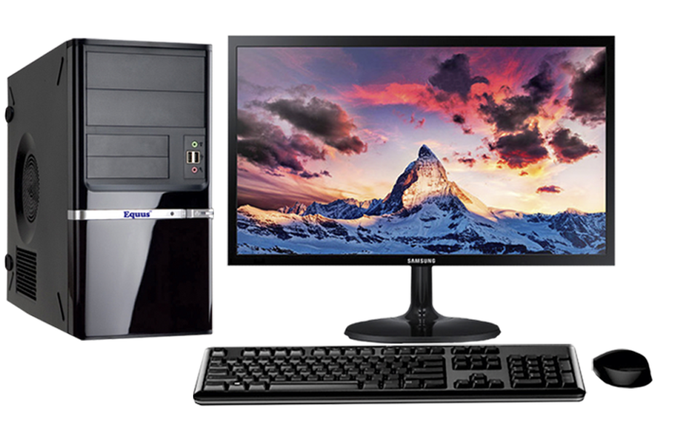
What is Computer Security?
Hardware
Computer system
Printers
Scanners
Software
OS
Applications
Utilities
Data
Documents
Emails
Personal Files

Slide 6
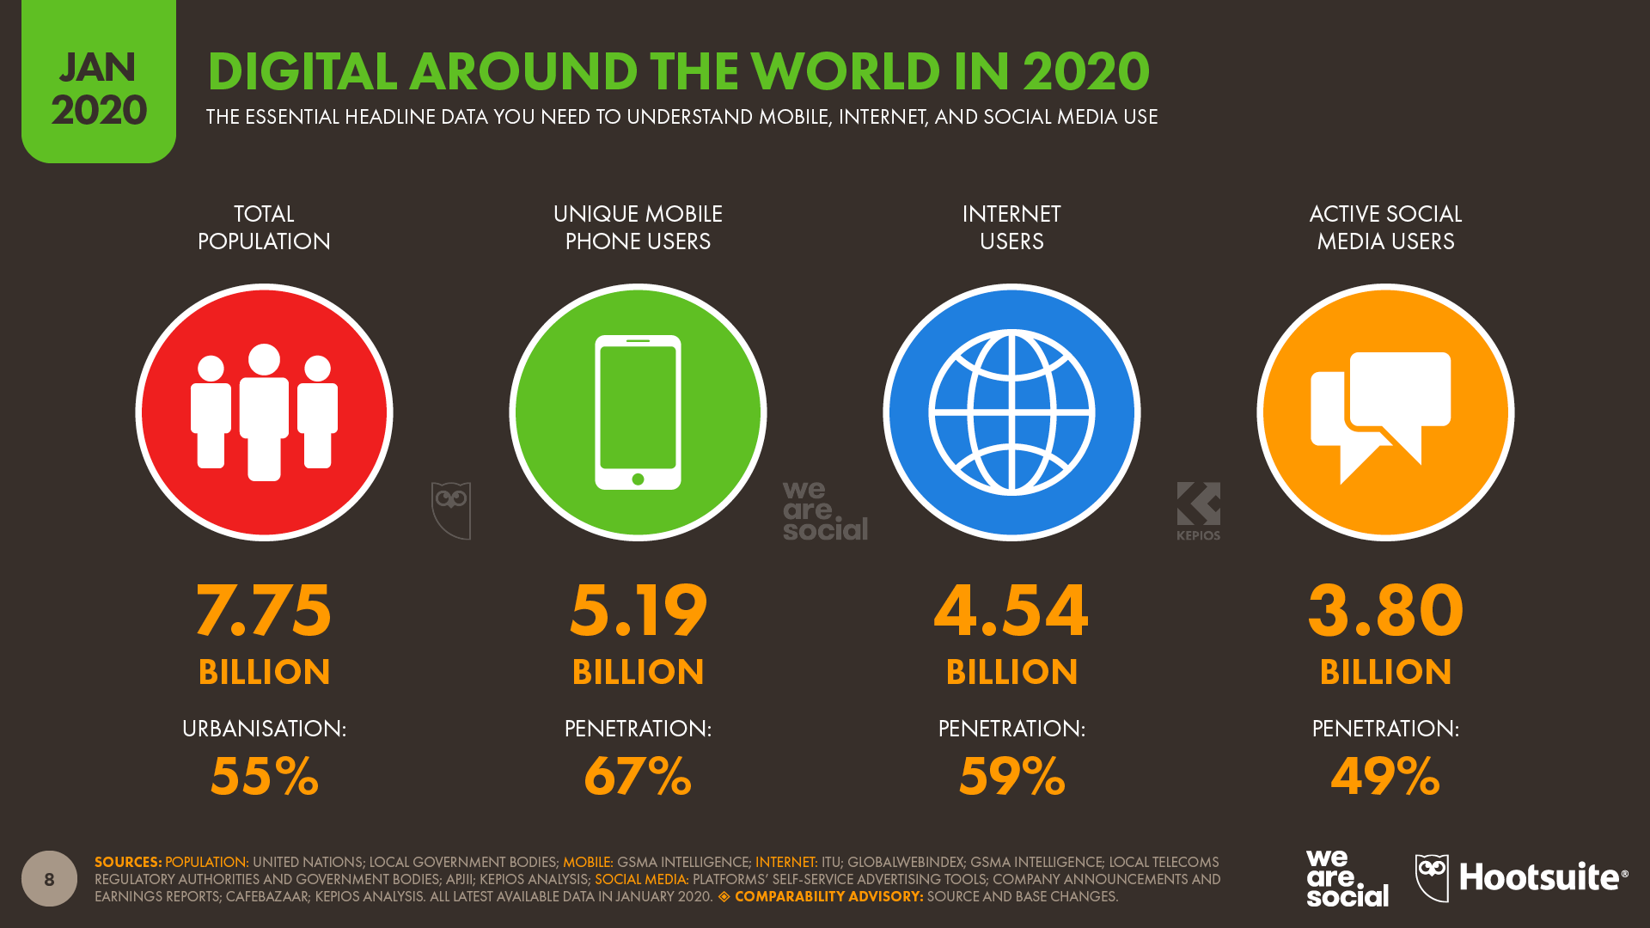

Slide 7
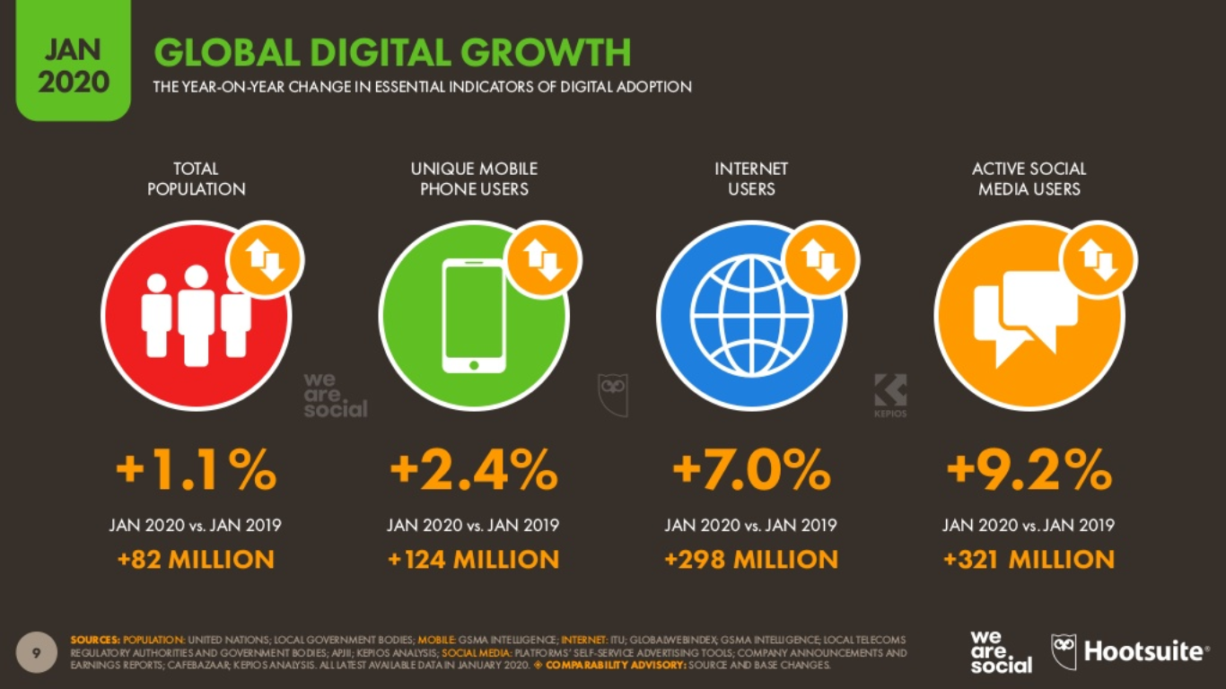

Slide 8
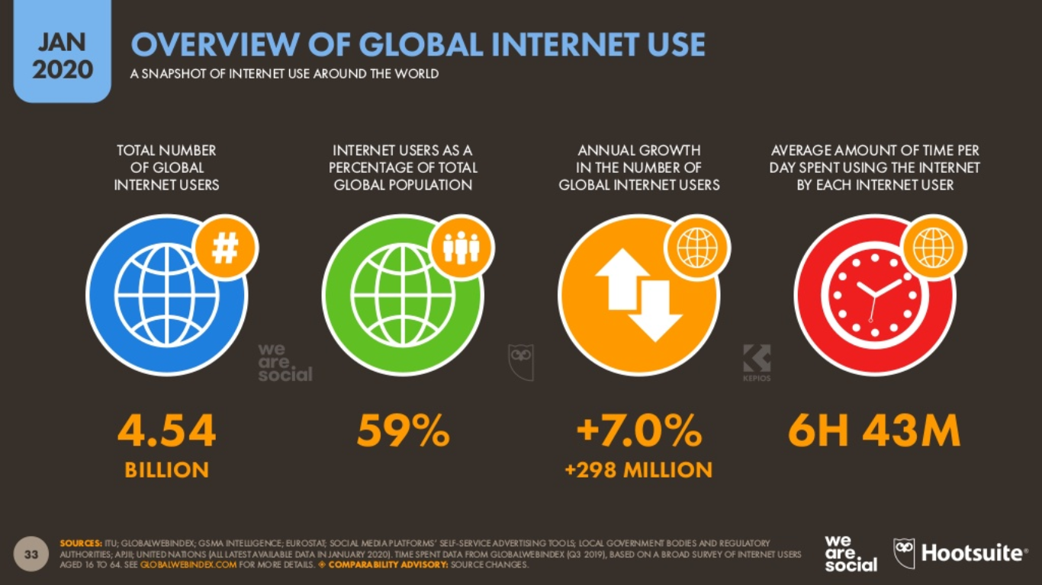

Slide 9
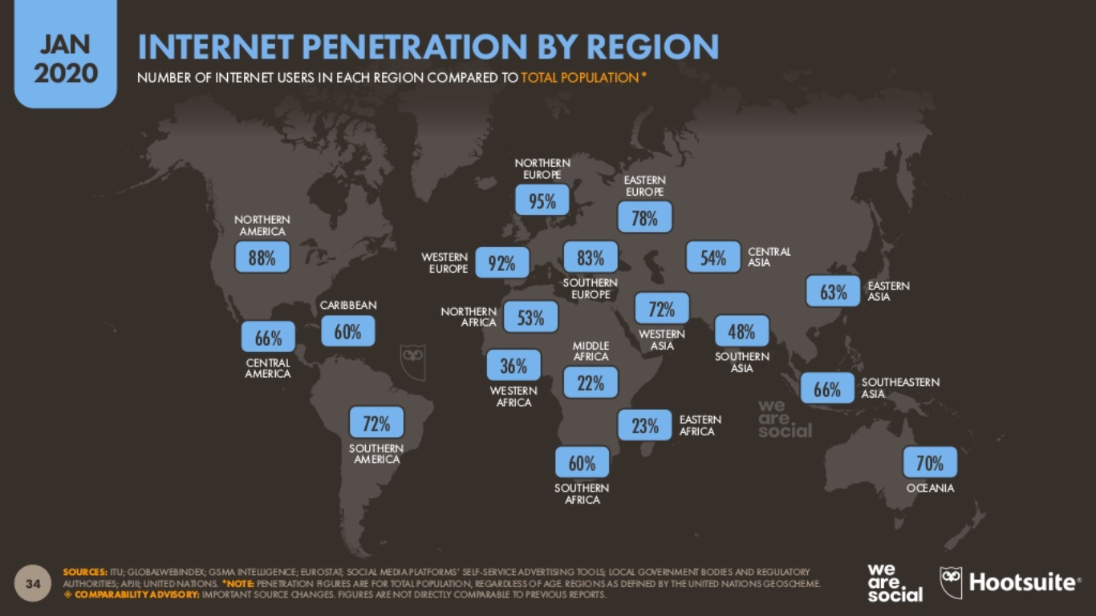

Slide 10
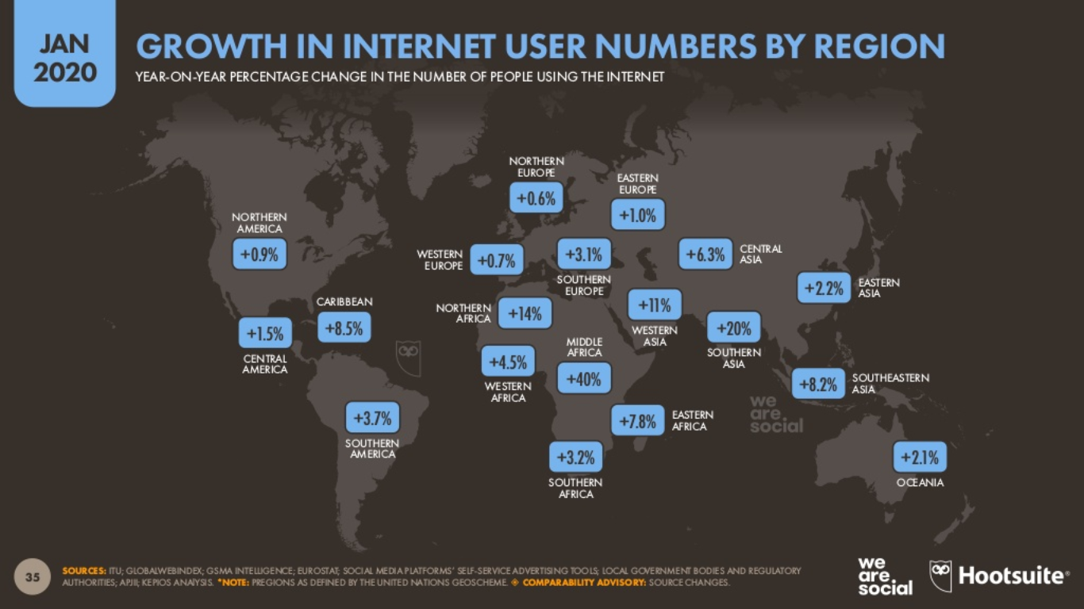

Slide 11
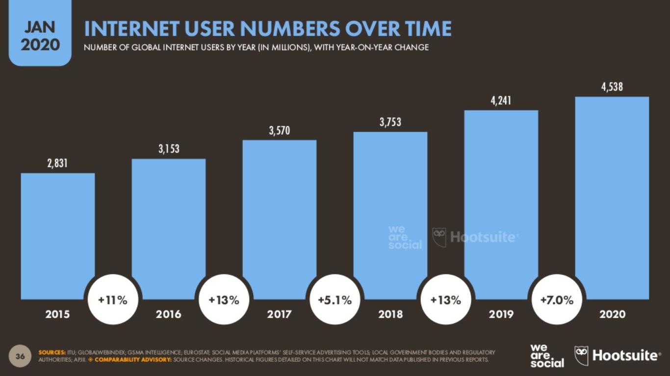

Slide 12
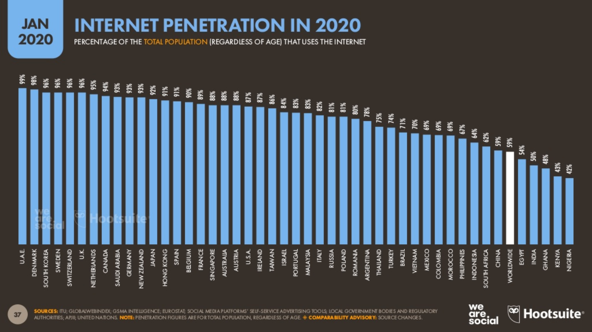

Slide 13
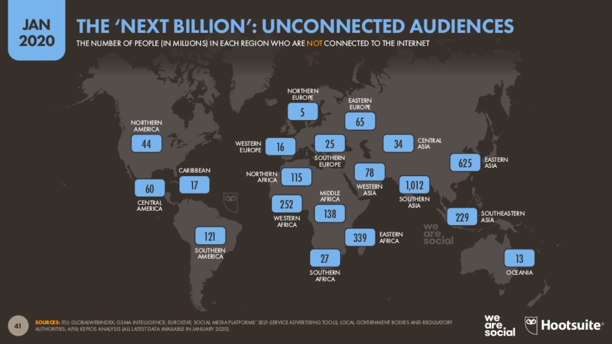

Slide 14
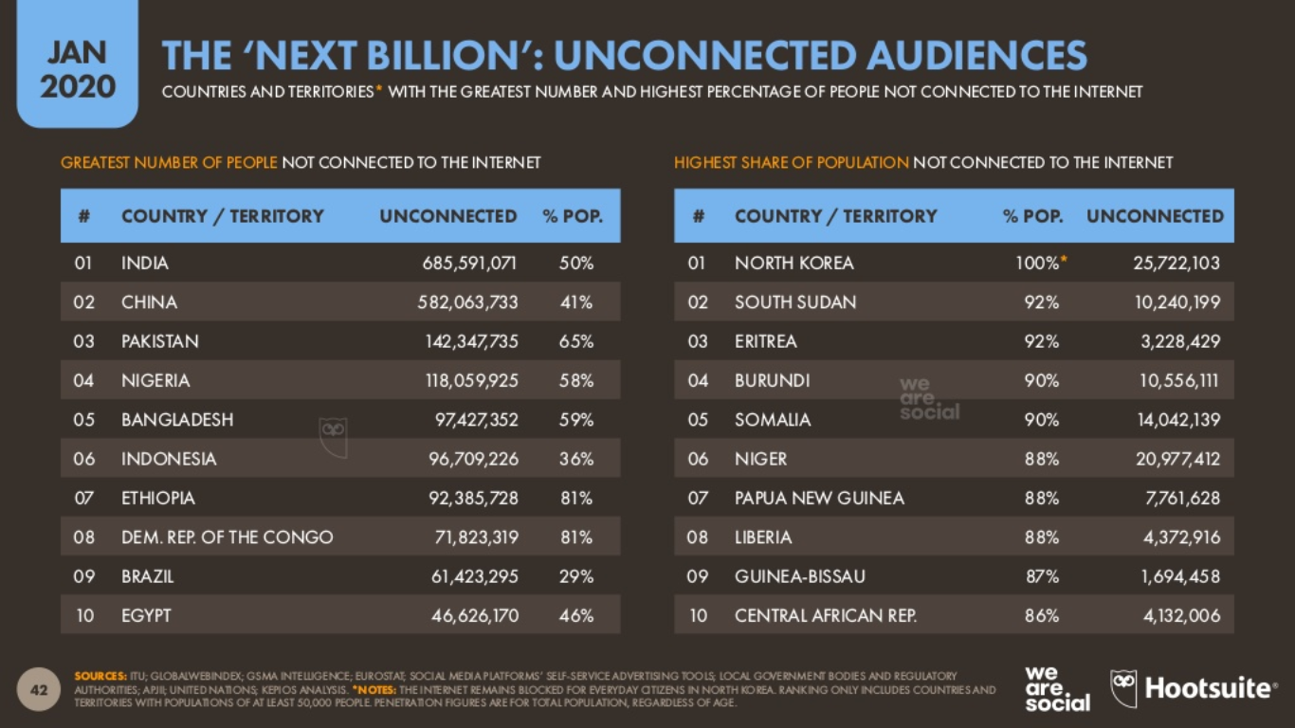

Slide 15
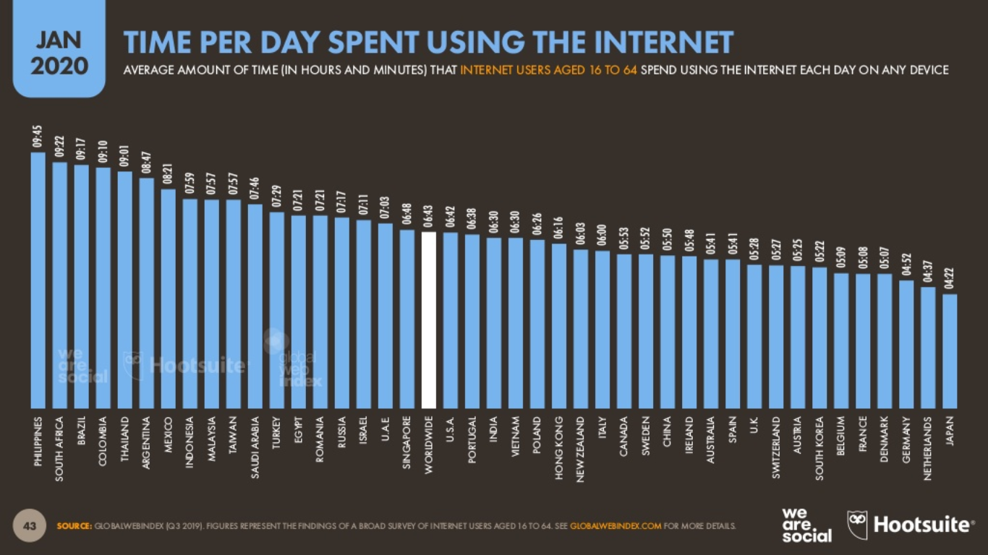

Slide 16
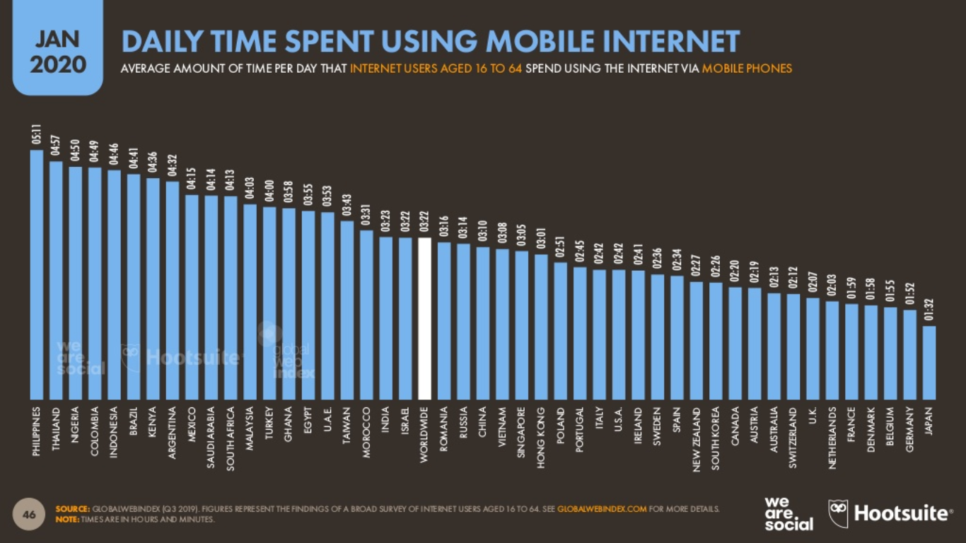

Slide 17
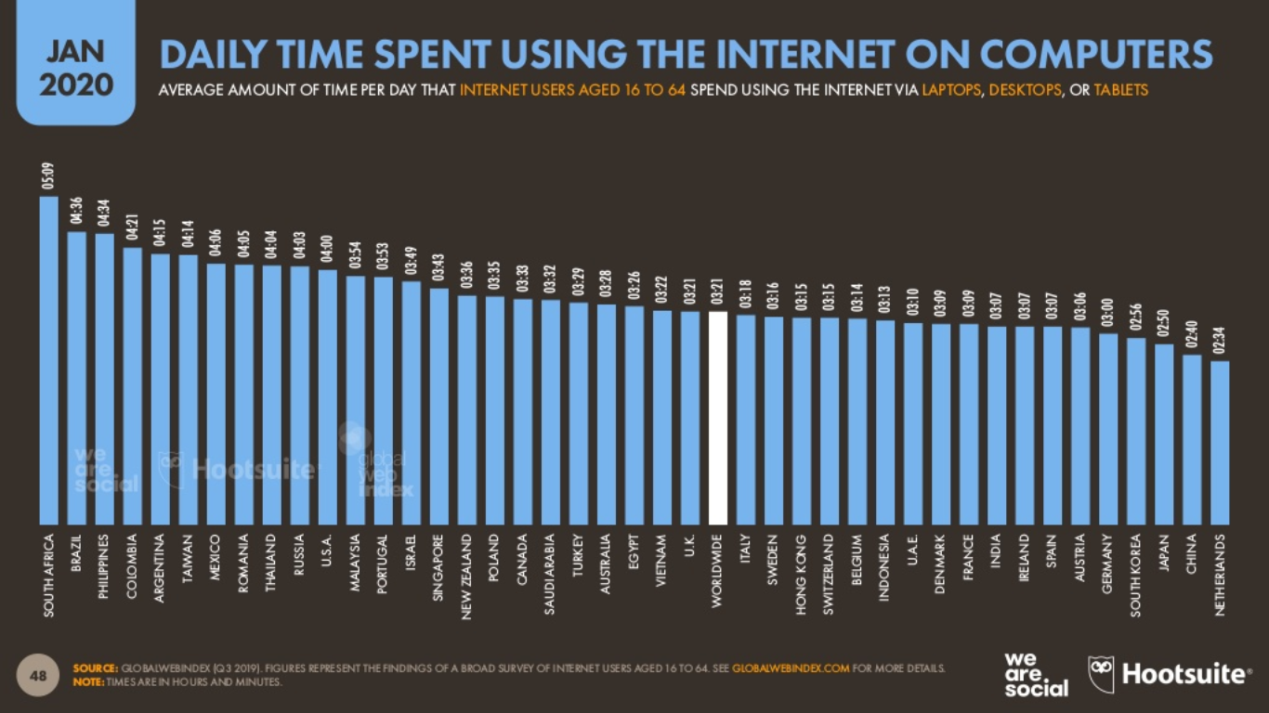

Slide 18
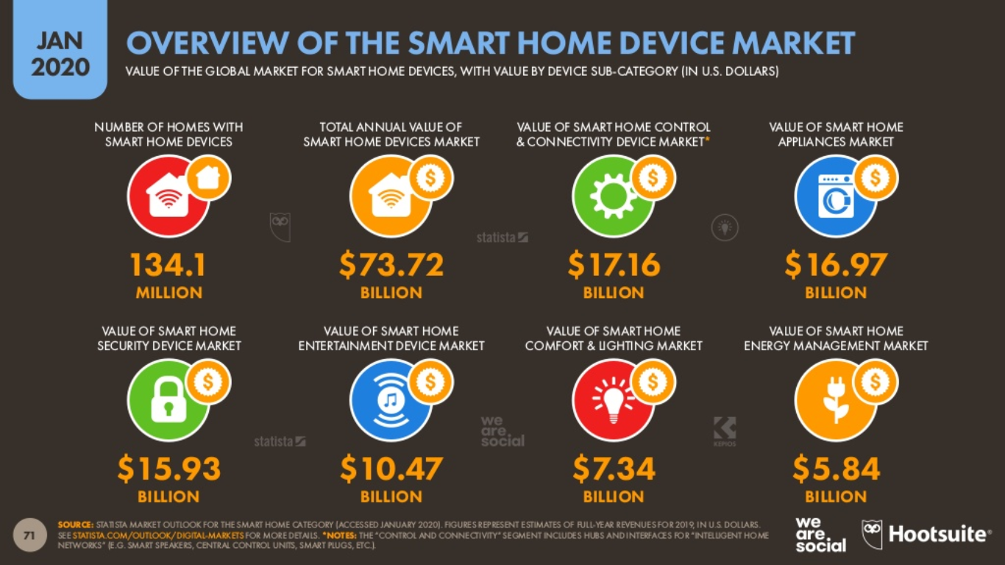

Slide 19
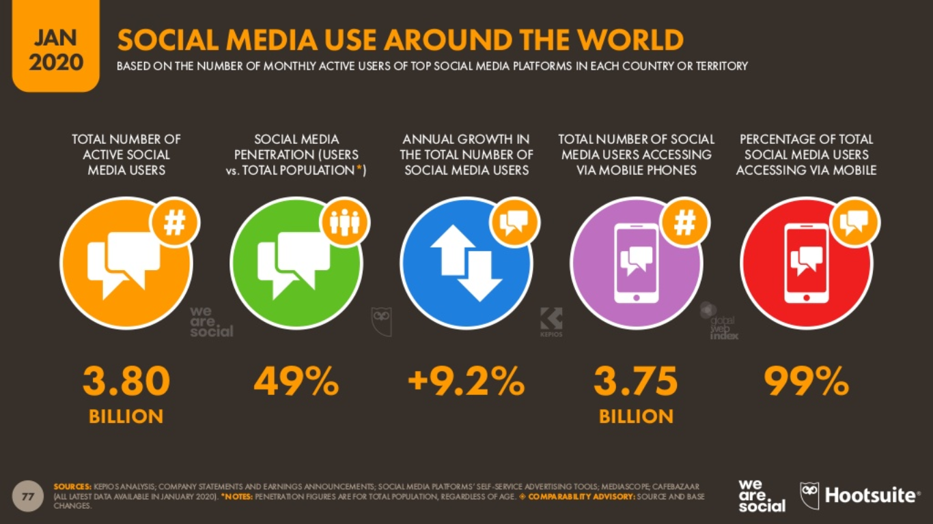

Slide 20
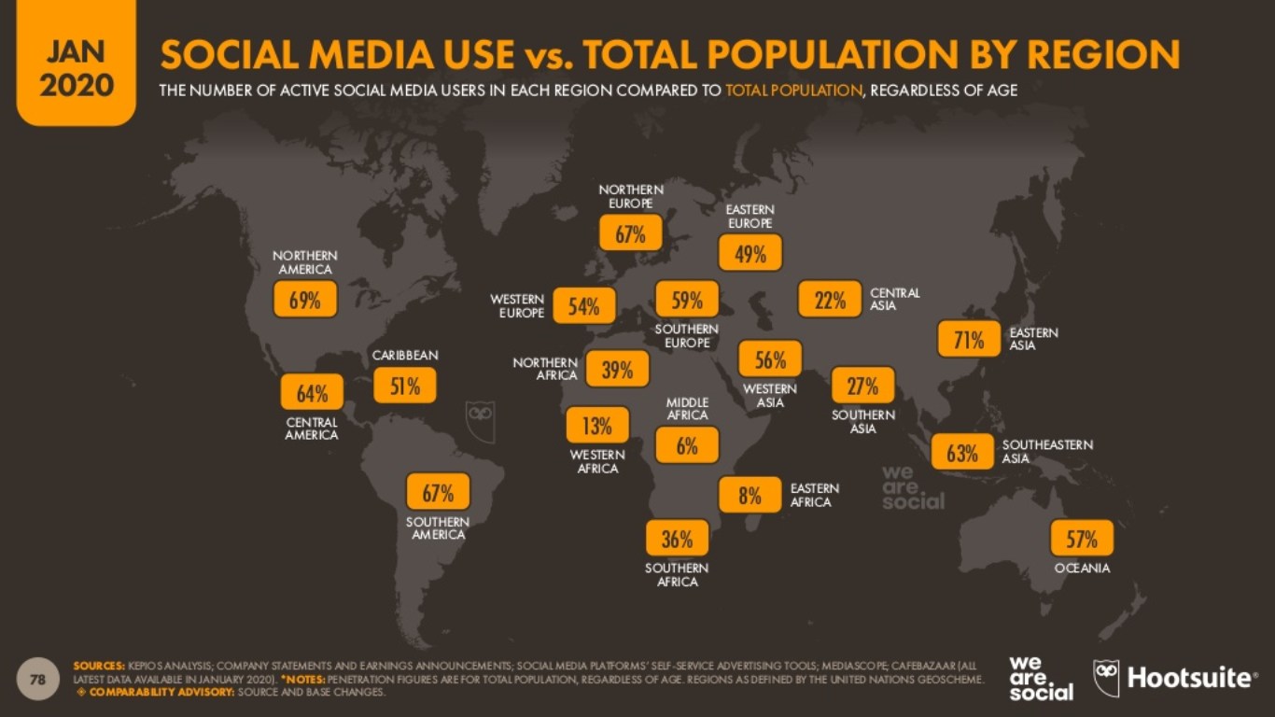

Slide 21
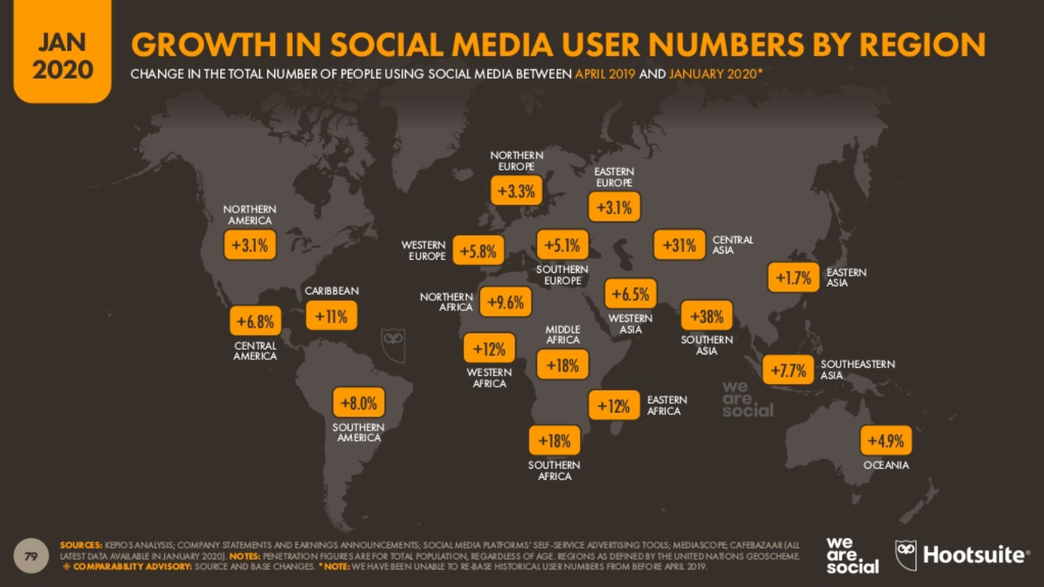

Slide 22
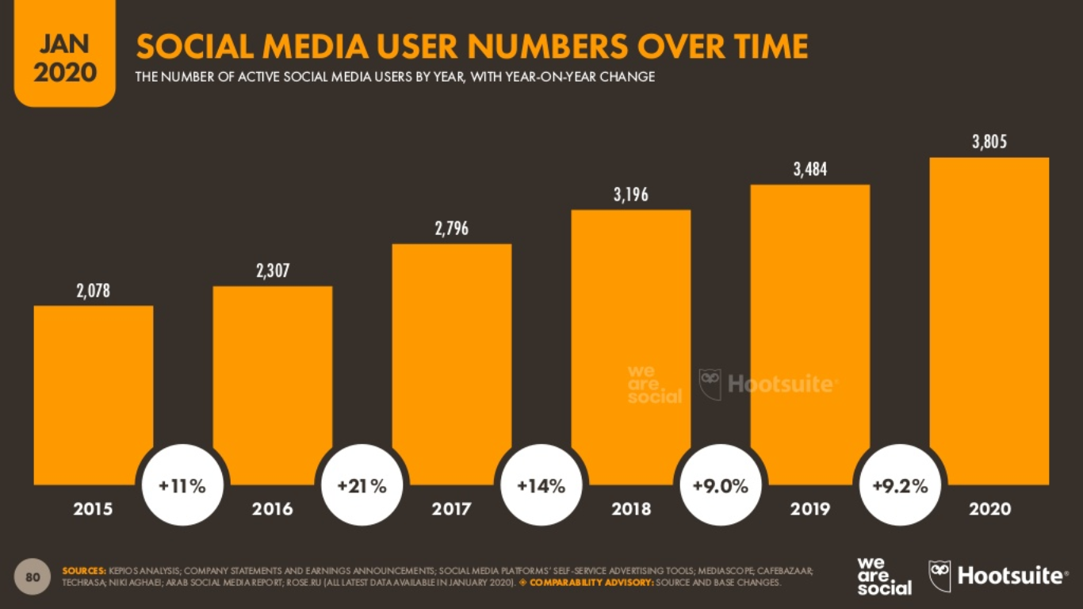

Slide 23
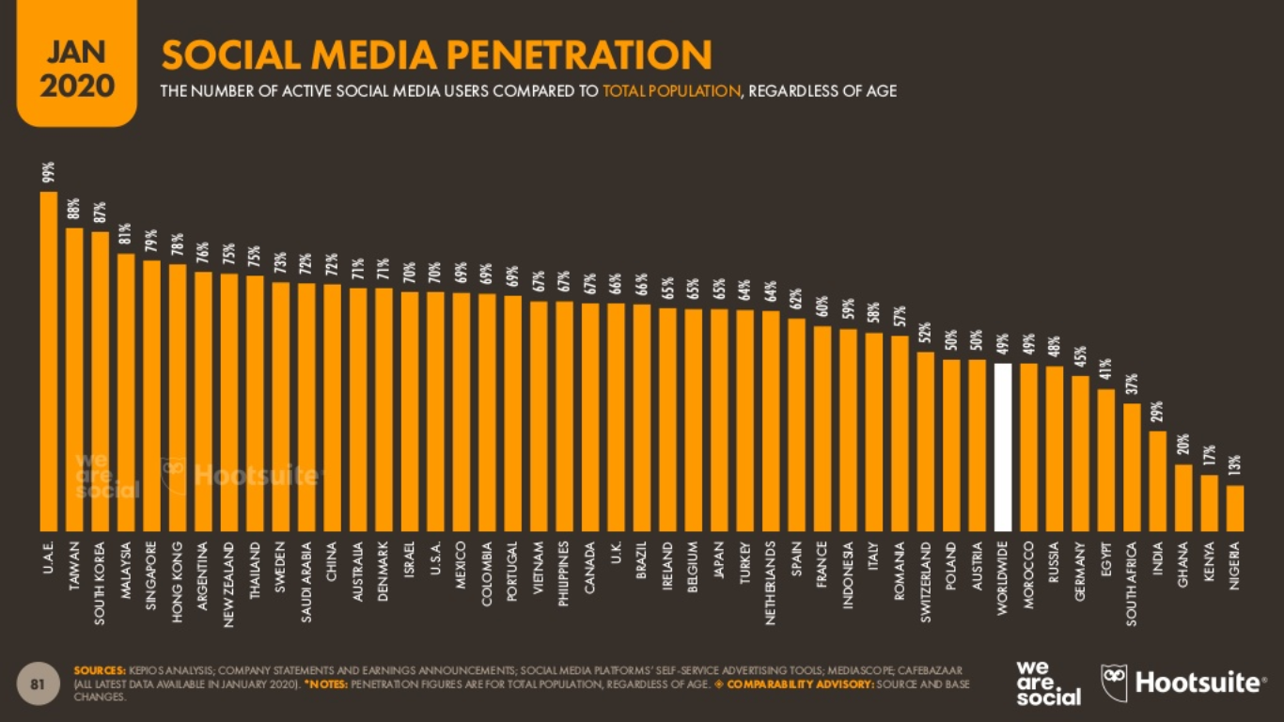

Slide 24
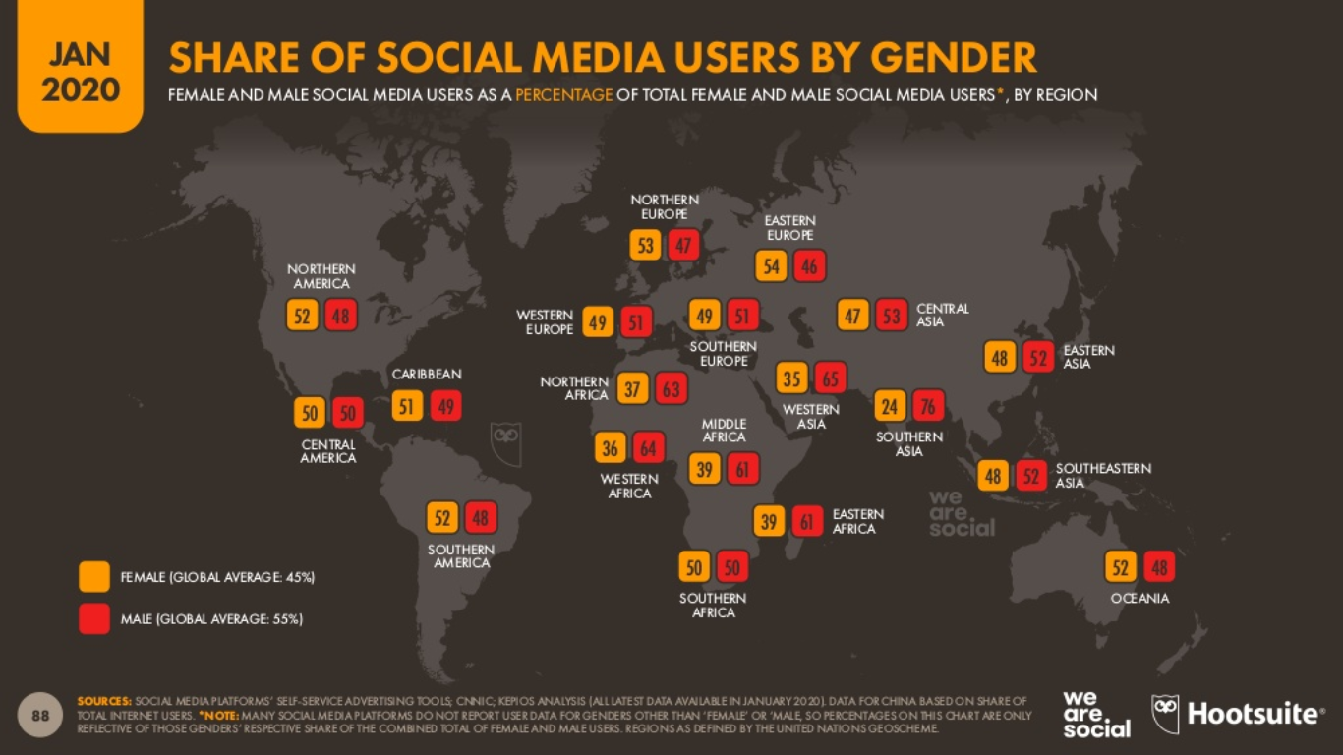

Slide 25
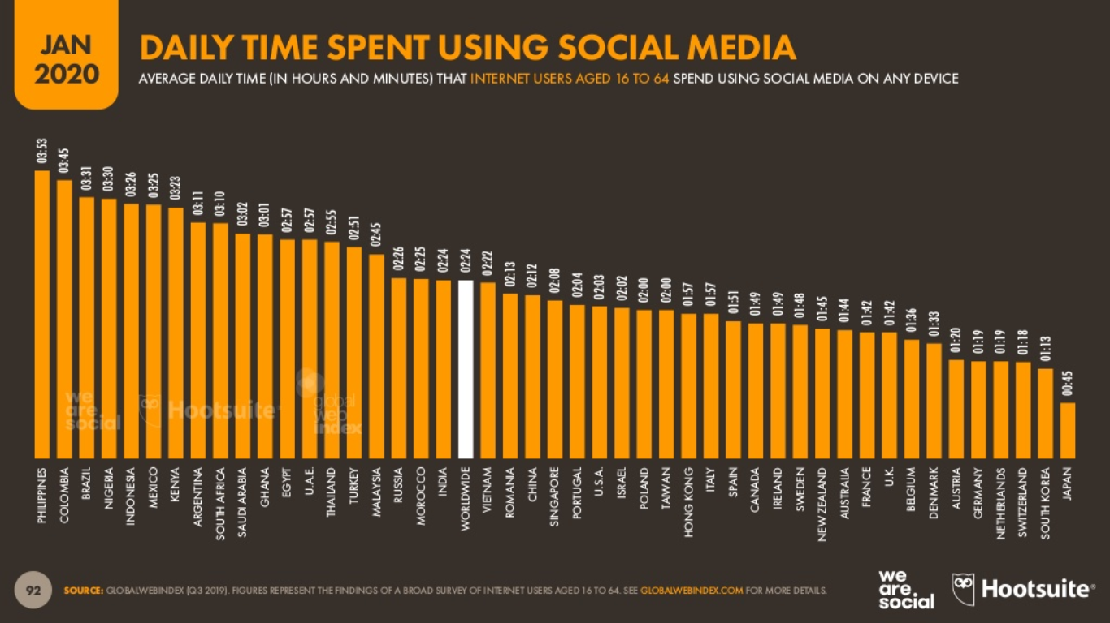

Slide 26
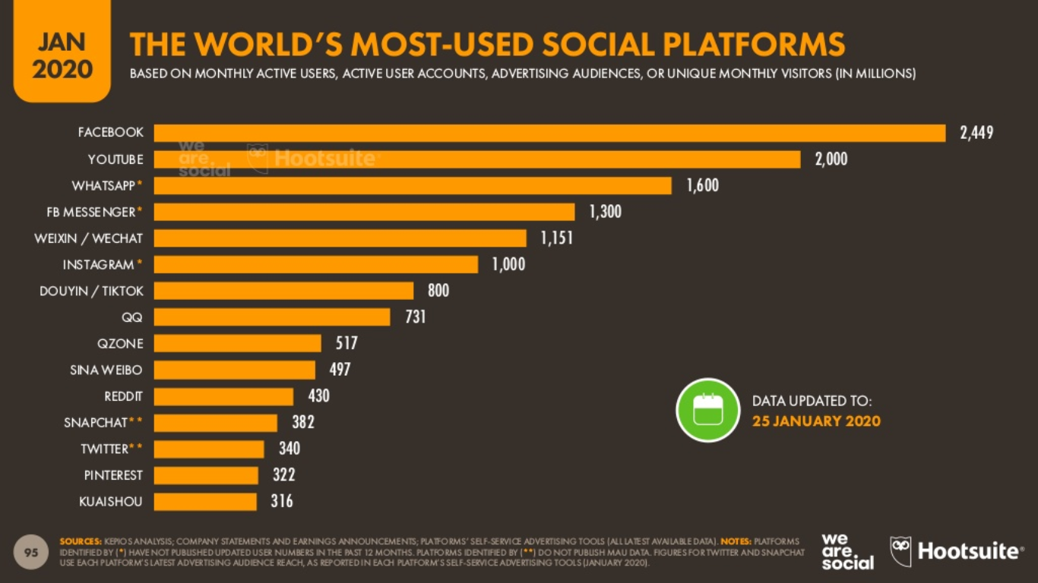

Slide 27
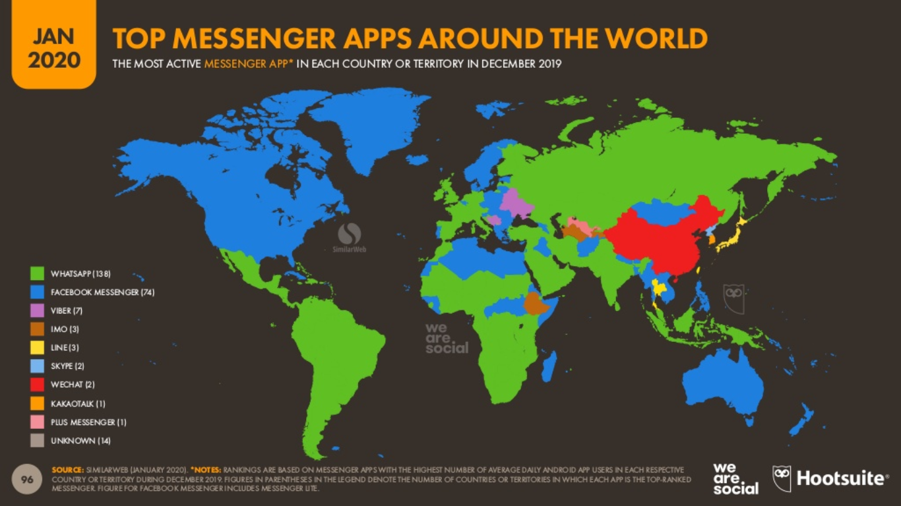

Slide 28
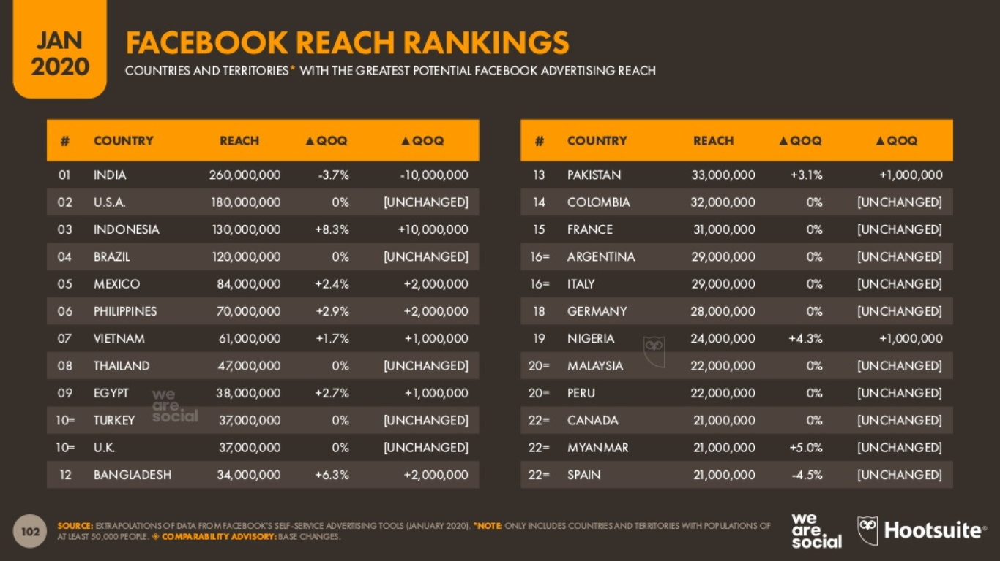

Slide 29
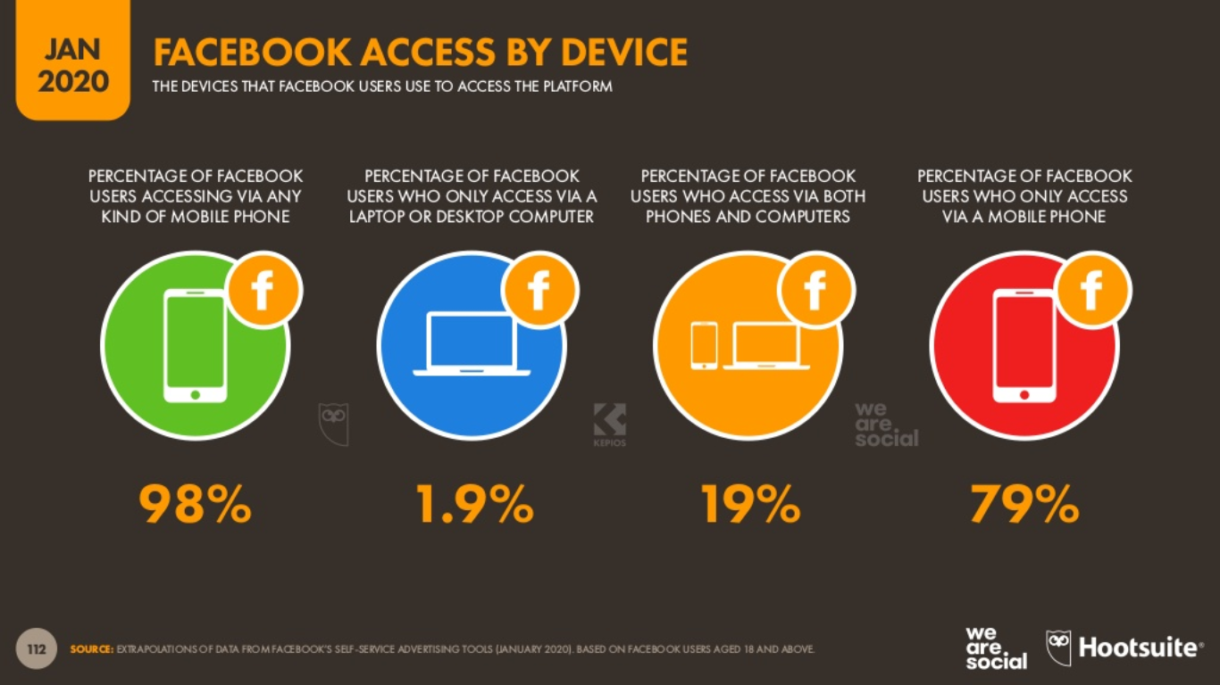

Slide 30
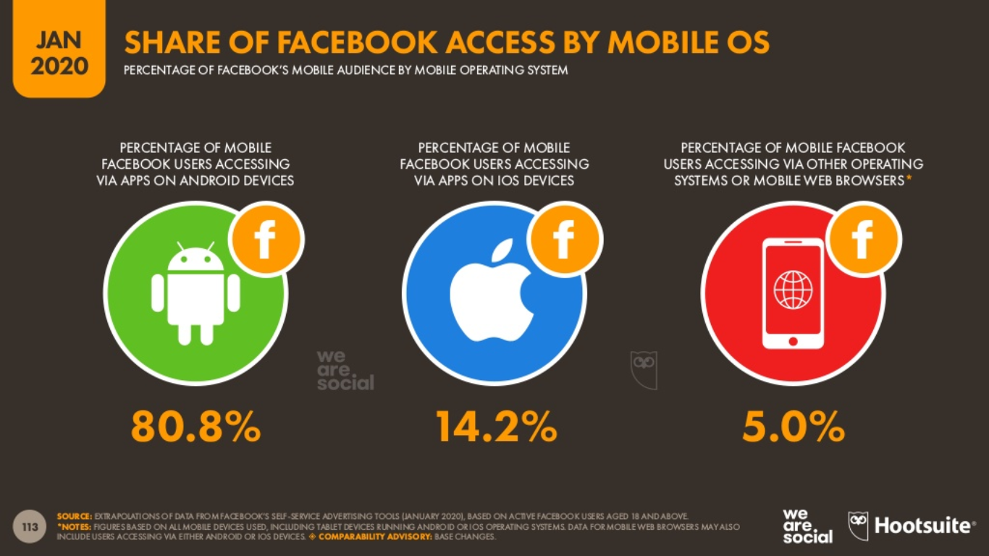

Slide 31
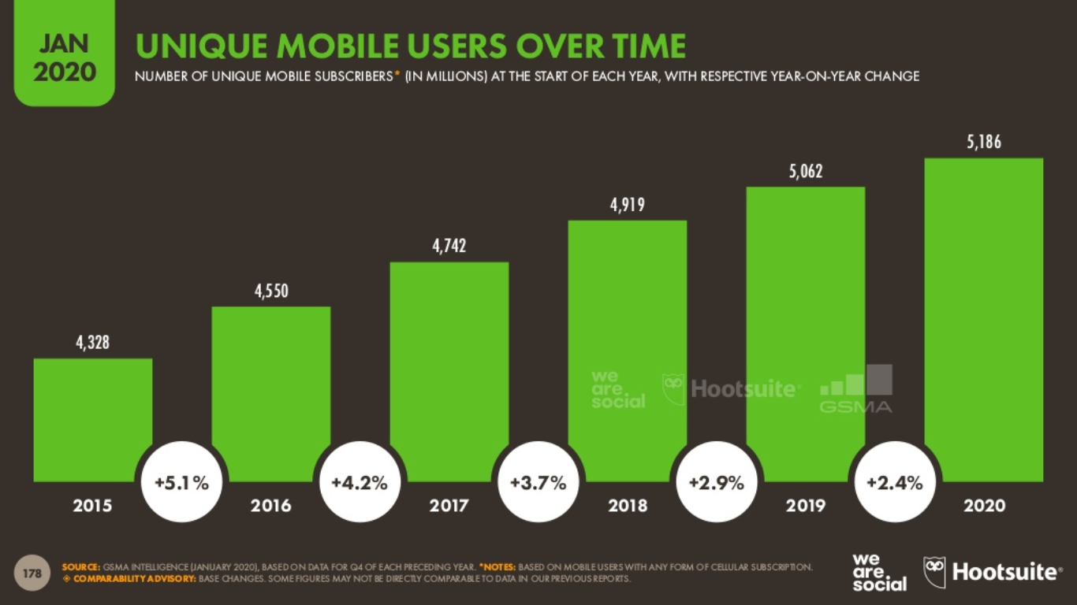

Slide 32
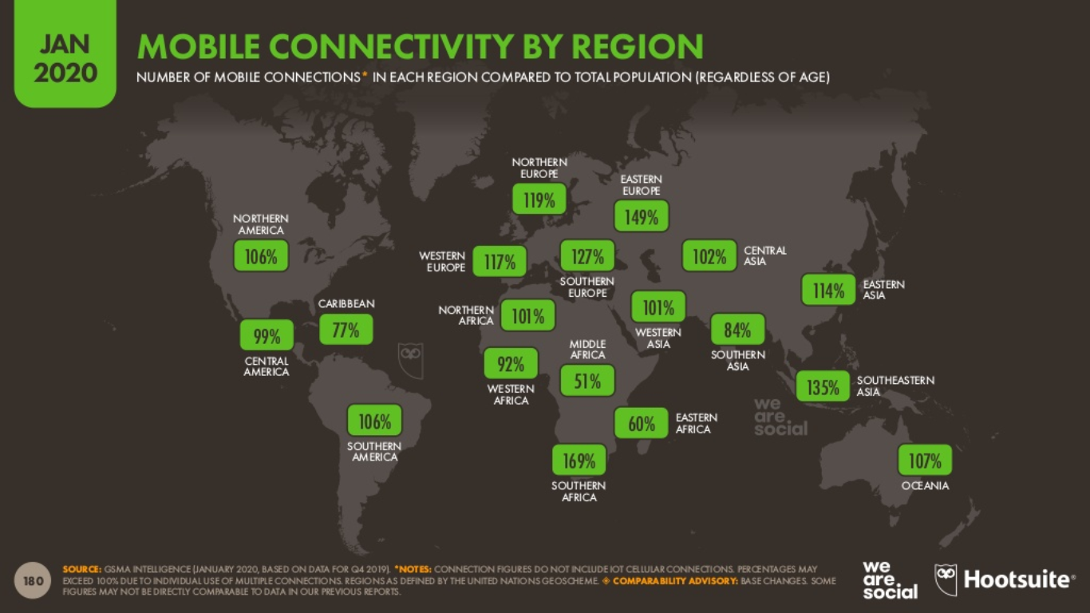

Slide 33
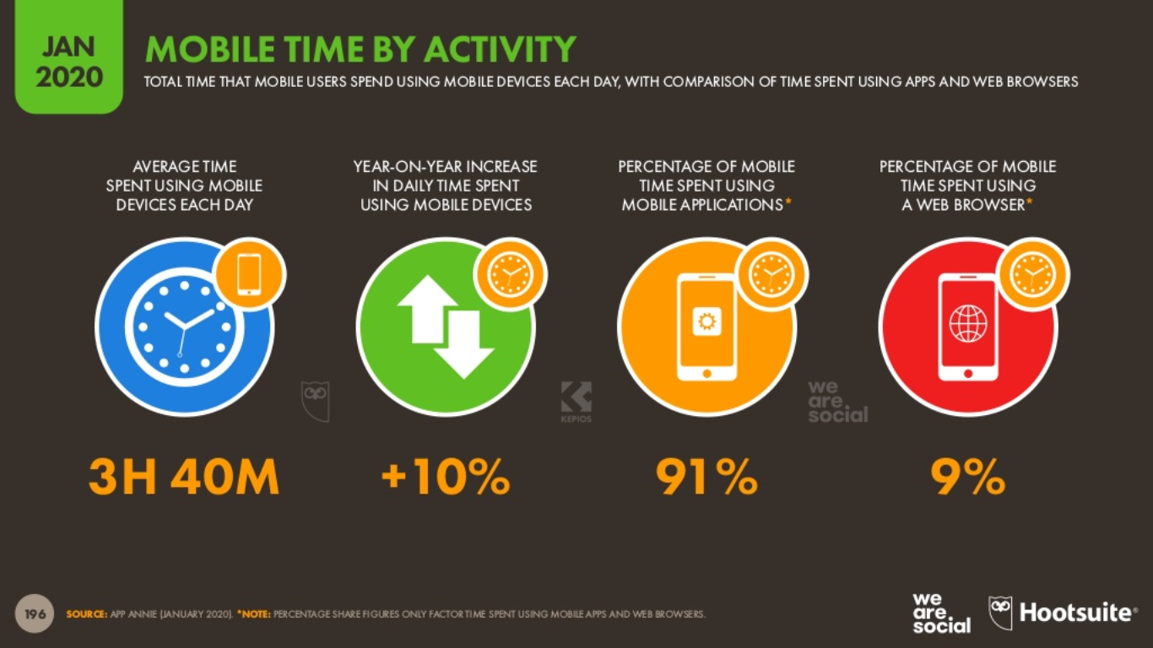

Slide 34
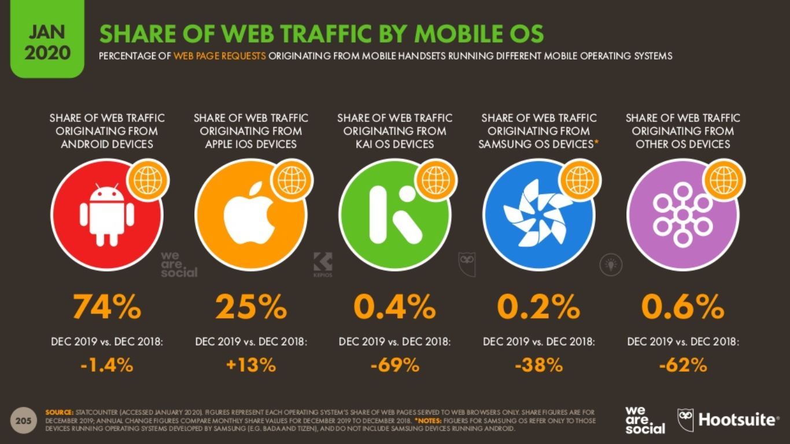

Slide 35
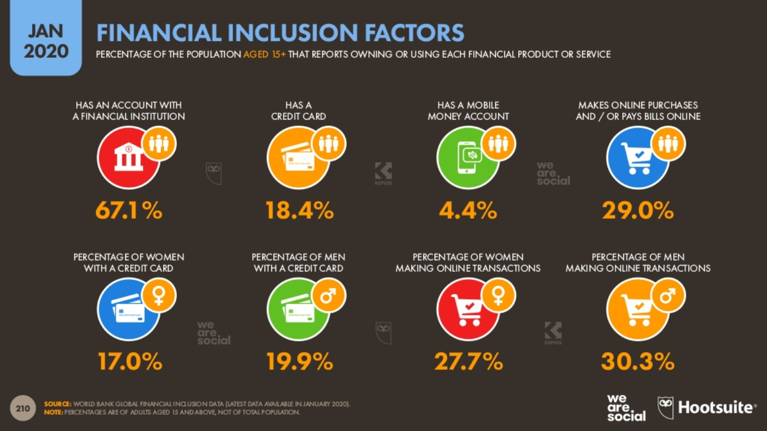

Slide 36
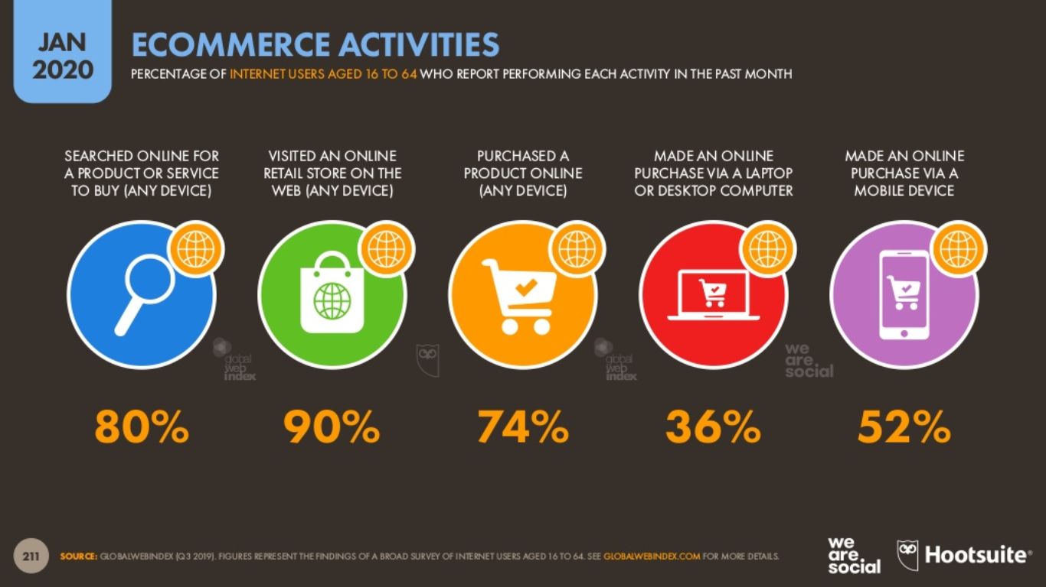

Slide 37
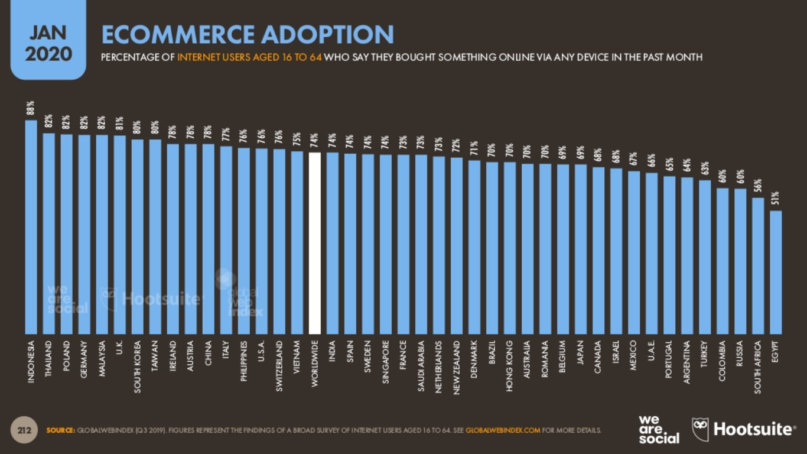

Slide 38
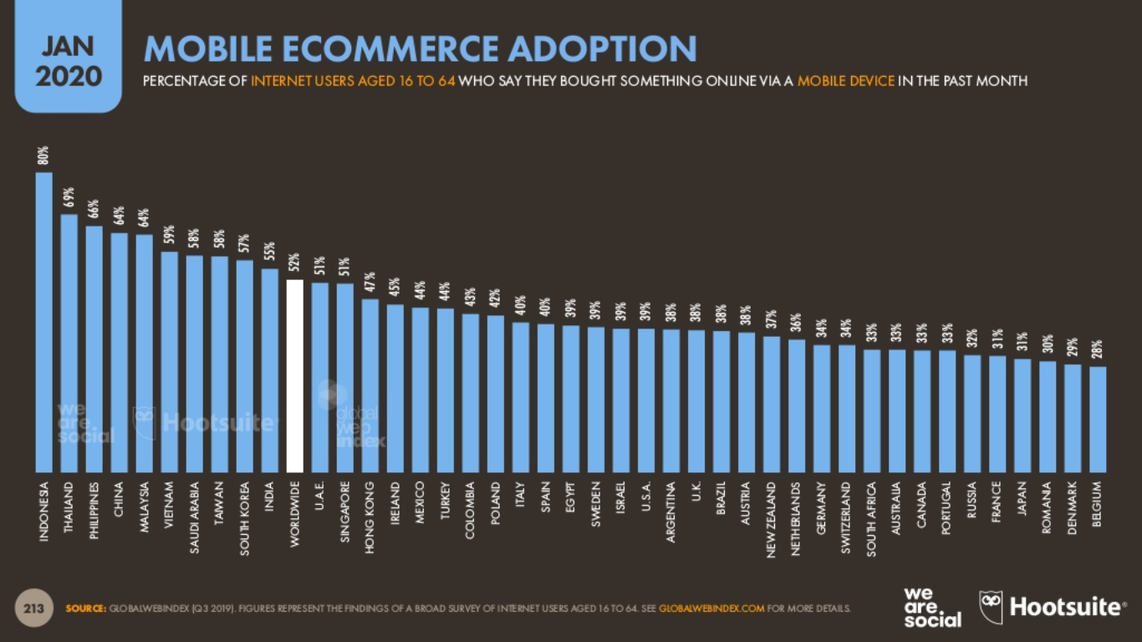

Slide 39
World is becoming increasingly interconnected
Internet is a network concerning millions of systems
Connected devices - in virtually every home and computer networks are the nervous systems of corporate and government organizations everywhere
Internet was designed for robustness and redundancy, rather than security and traceability

Slide 40
Individuals also use computing devices heavily in their daily lives
It is rare to see a person who is not dependent on some form of computing device to organize his or her digital data or to communicate with others

Slide 41
The threat of cybersecurity is unquestionably growing more serious over time
Worldwide spending on cybersecurity is forecasted to reach $133.7 billion in 2022
Data breaches exposed 4.1 billion records in the first half of 2019
68% of business leaders feel their cybersecurity risks are increasing
The average time to identify a breach in 2019 was 7 months

Slide 42
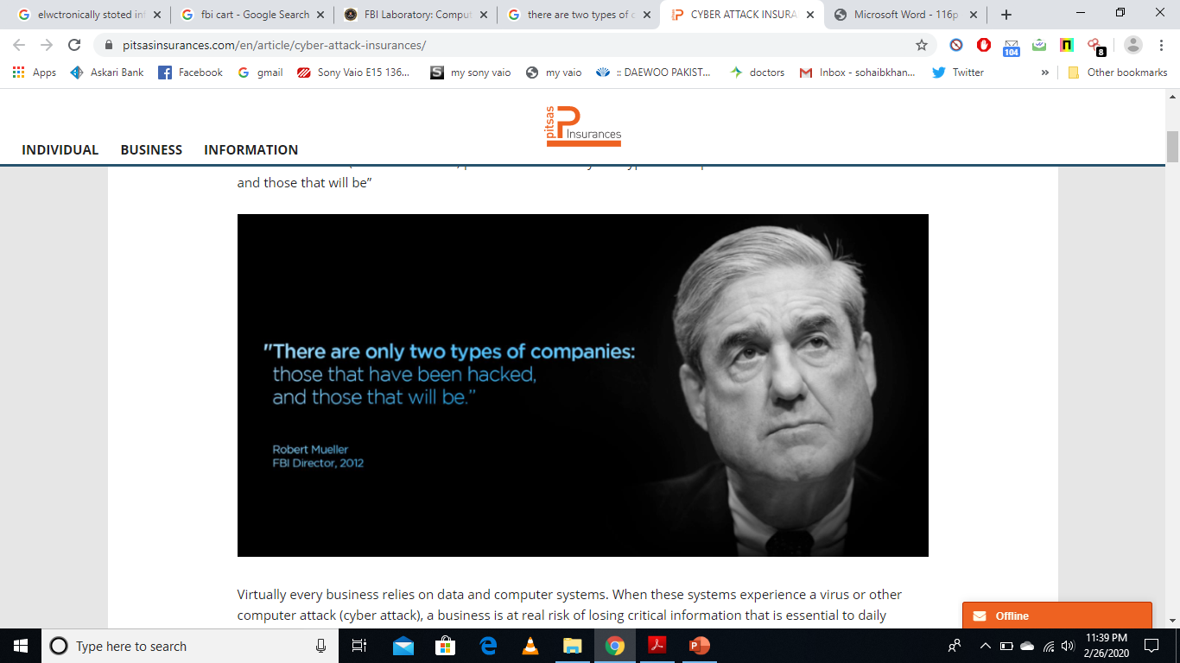

Slide 43
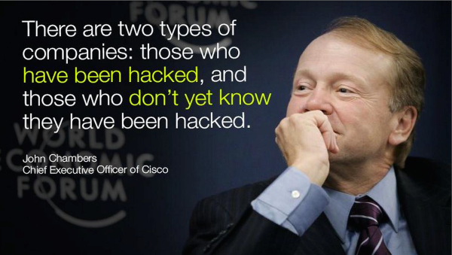

Slide 44
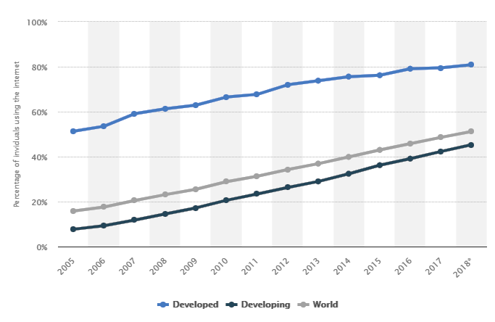
INTERNET USAGE
* https://www.statista.com/statistics/209096/share-of-internet-users-in-the-total-world-population-since-2006/

Slide 45
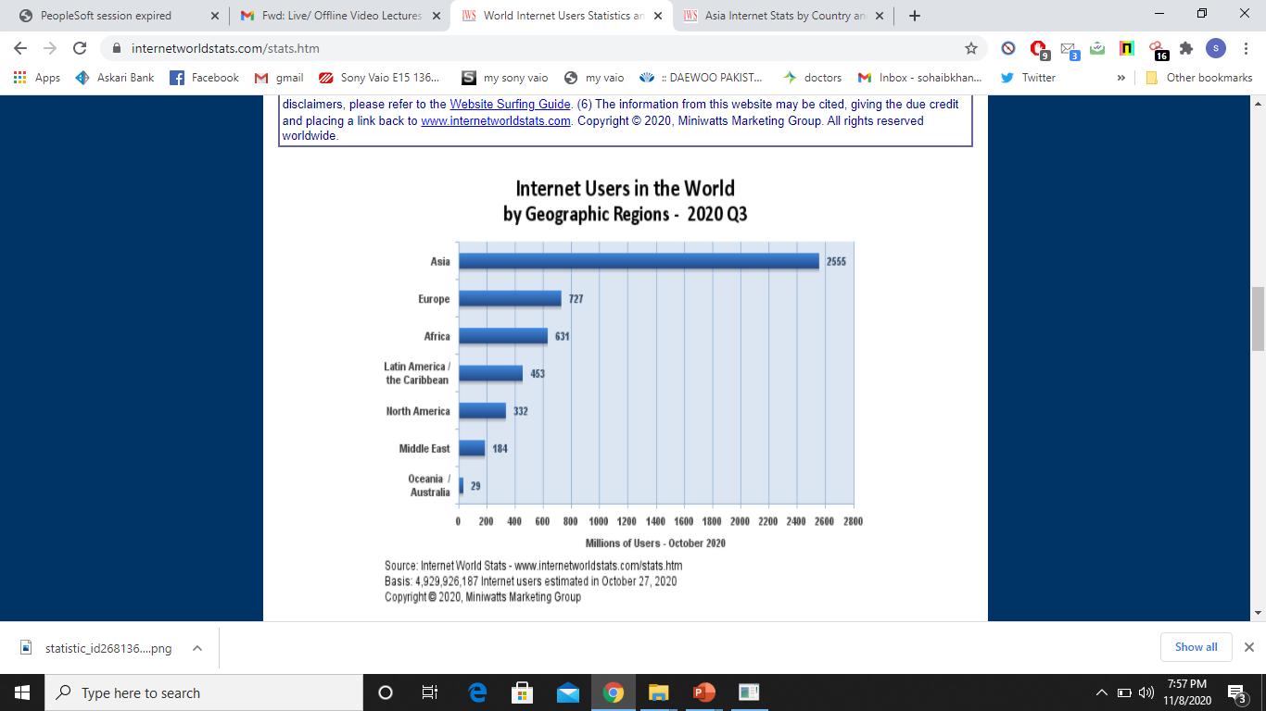
INTERNET USAGE
* http://www.internetworldstats.com/stats.htm

Slide 46
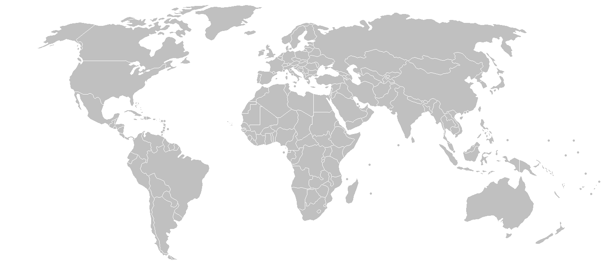
INTERNET USAGE
UK
94.6 %
GERMANY
96 %
RUSSIA
76.1 %
JAPAN
93.5 %
AMERICA
89%
FRANCE
92.3 %
CHINA
60.1 %
PAK
32.4 %
South Korea
95.9 %
BRAZIL
70.7 %
AUSTRALIA
87.8 %
INTERNET USAGE
* http://www.internetworldstats.com/stats.htm

Slide 47
Global cyber security index (GCI)

Slide 48
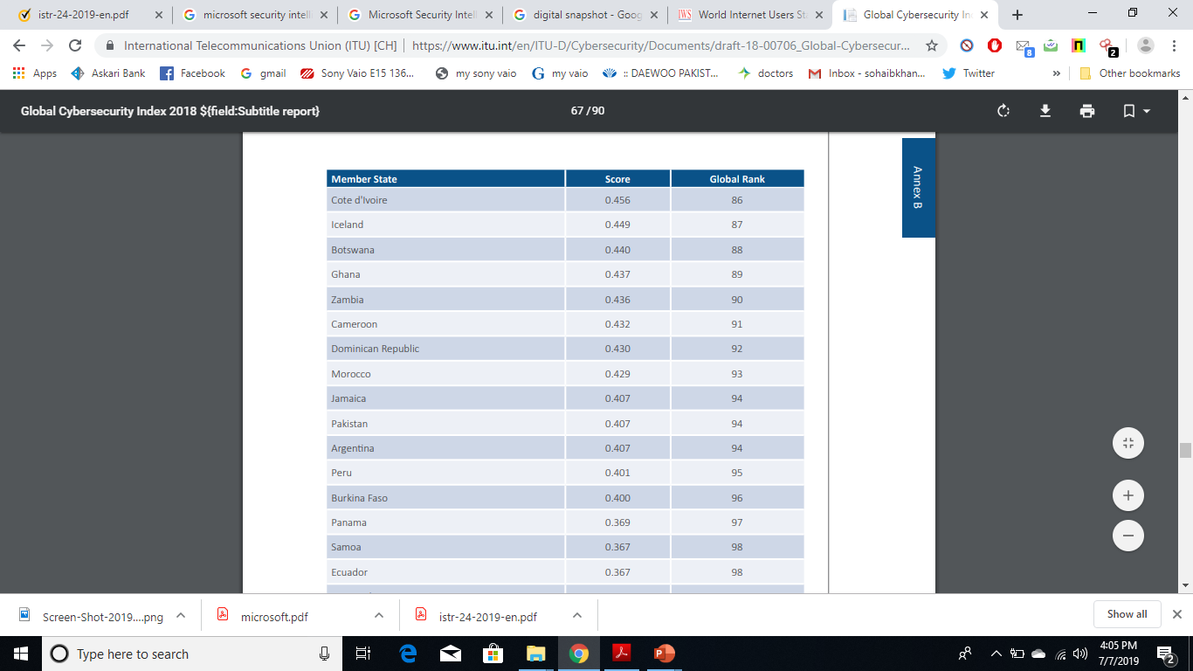
Ranks 94 on Global cyber security index (GCI)

Slide 49
* Internet Security Threat Report – Volume 22 (Symantec)

Slide 50
2017
55 %
1 in
2,995
1 in
412
669 M
62 % rise
* Internet Security Threat Report – Volume 22, 23 (Symantec)

Slide 51
* Internet Security Threat Report – Volume 22,23 (Symantec)

Slide 52
2017
611k
* Internet Security Threat Report – Volume 22,23 (Symantec)

Slide 53
2017
678,497
28
* Internet Security Threat Report – Volume 22,23 (Symantec)

Slide 54
CYBER ENVMT - PAKISTAN

Slide 55
CYBER ENVMT - PAKISTAN

Slide 56
CYBER ENVMT - PAKISTAN
Total Vulnerabilities
Zero Day Vulnerabilities

Slide 57
TRENDS – 2018

Slide 58
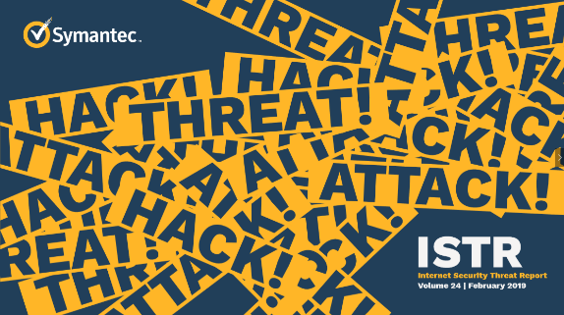

Slide 60
TRENDS – 2018
EMAILS

Slide 61
* Internet Security Threat Report – Volume 24 (Symantec)

Slide 62
* Internet Security Threat Report – Volume 24 (Symantec)

Slide 76
TRENDS – 2018
MALWARES

Slide 89
TRENDS – 2018
WEB ATTACKS

Slide 95
So, what do attackers gain from security vulnerabilities….. ???

Slide 100
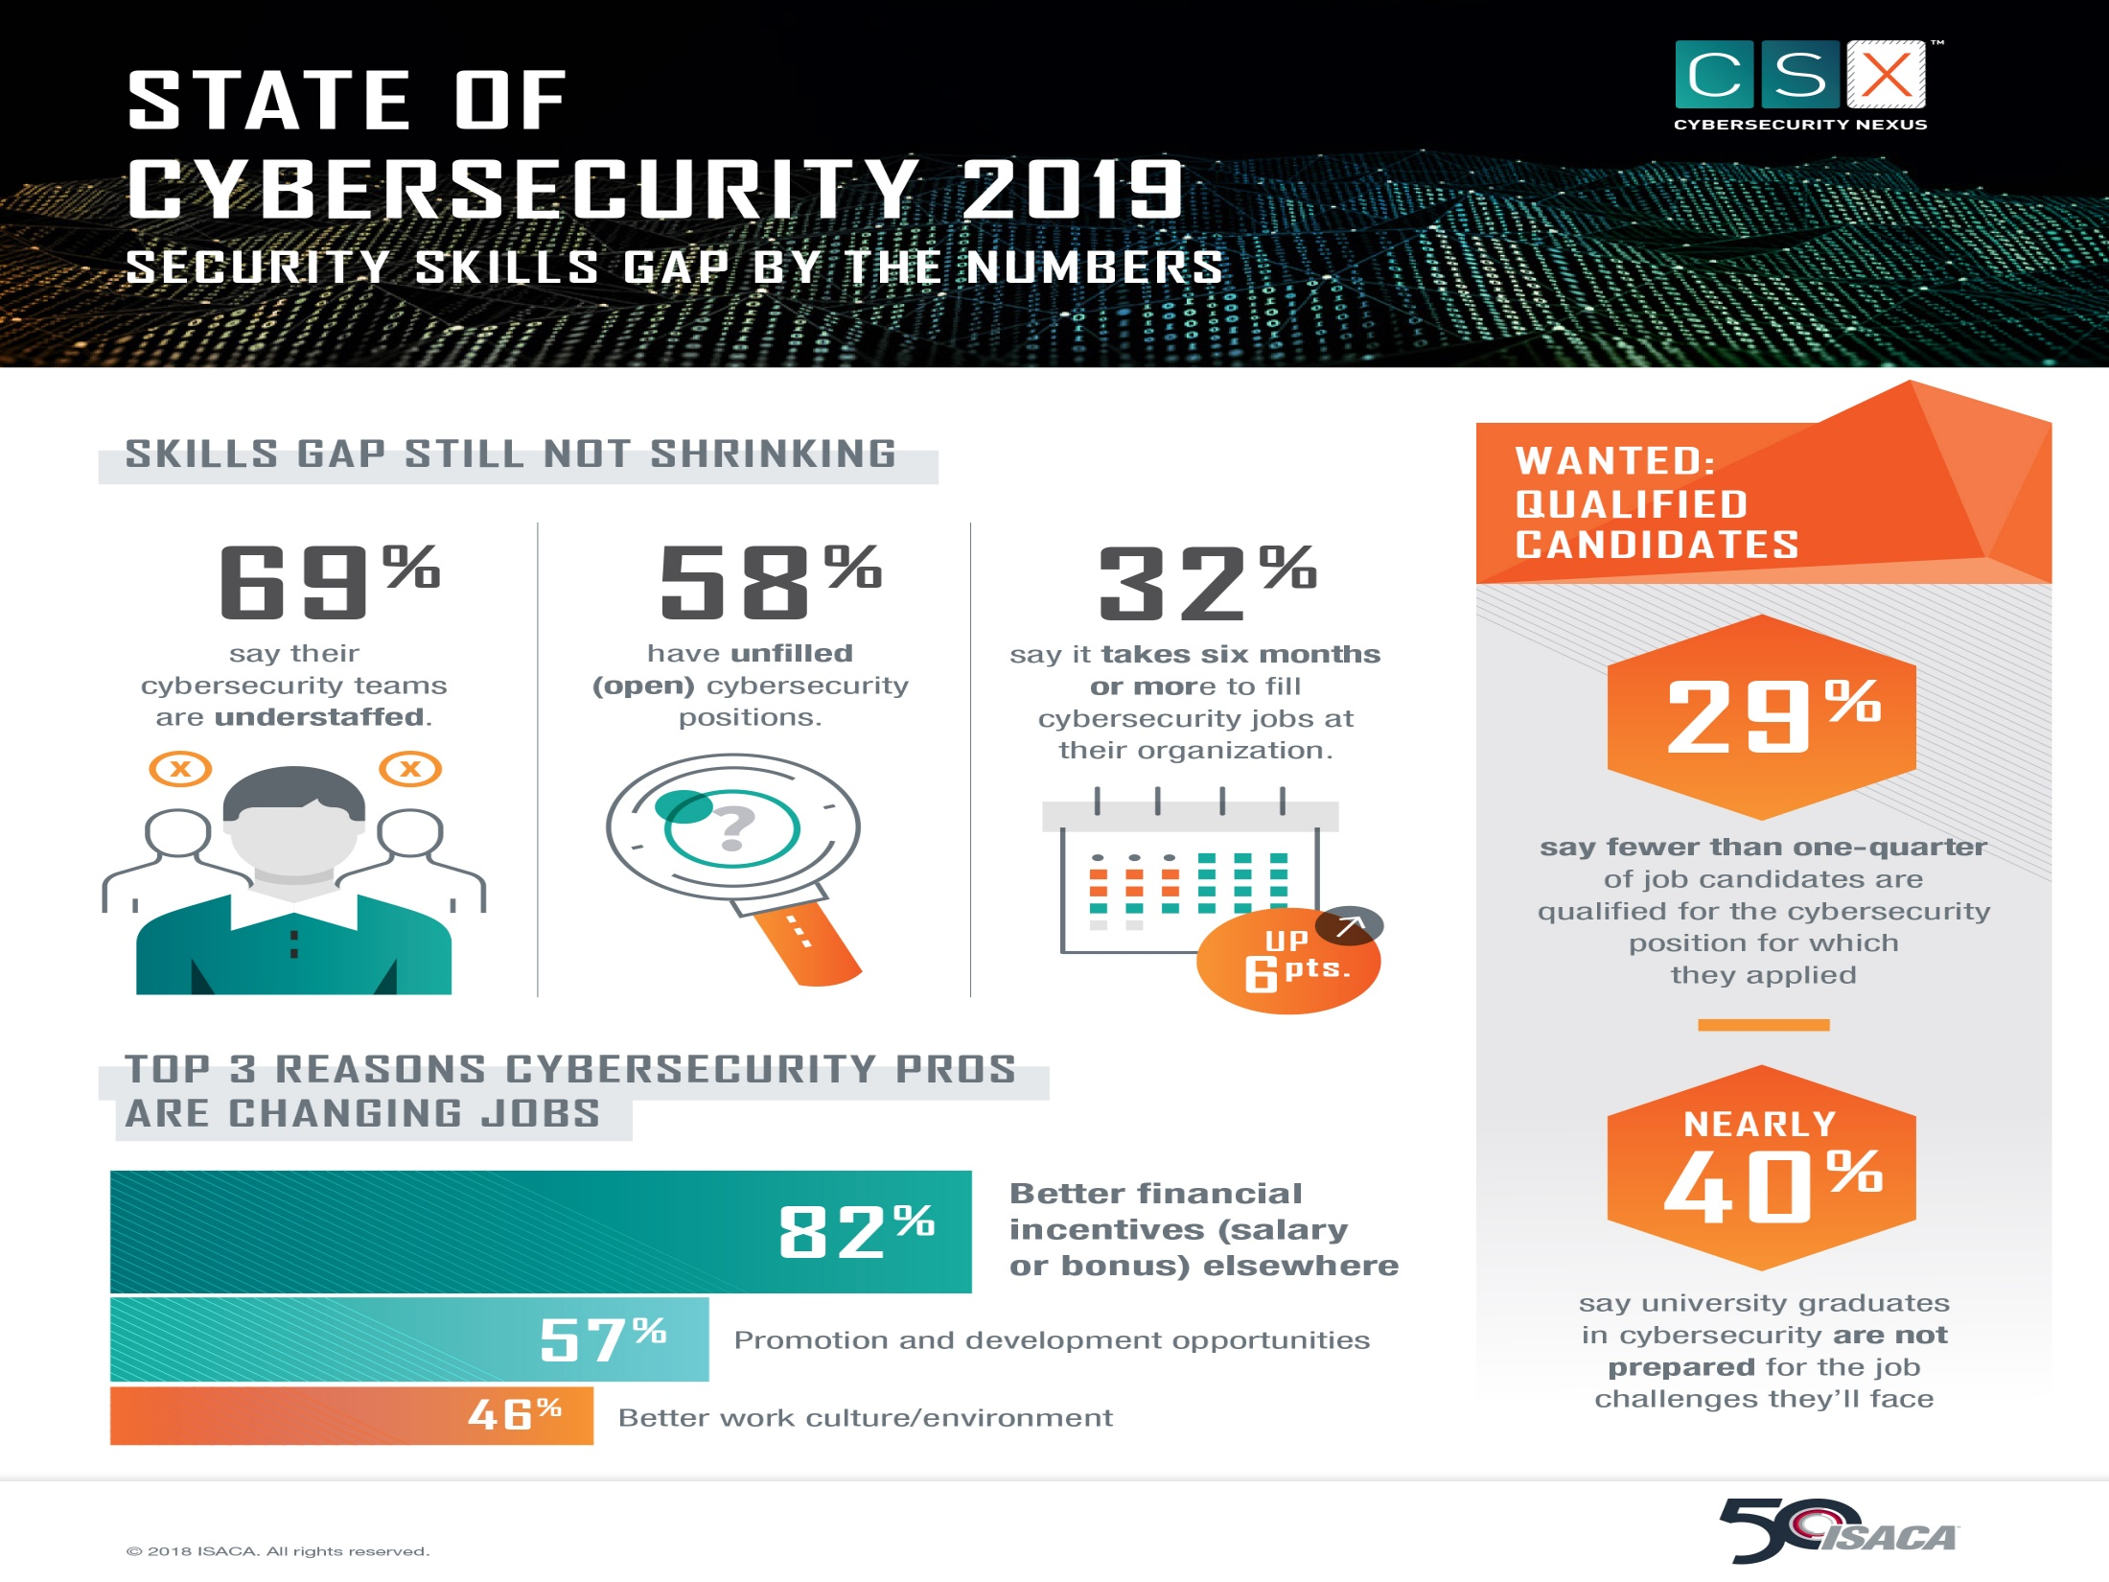

Slide 101
Encounter rate is simply the percentage of computers running Microsoft real-time security products that report a malware encounter, whether the infection attempt succeeds or not
Computers cleaned per mille, or CCM, is an infection rate metric that is defined as the number of computers cleaned for every 1,000 unique computers executing the Malicious Software Removal Tool (MSRT), a free tool distributed through Microsoft update

Slide 102
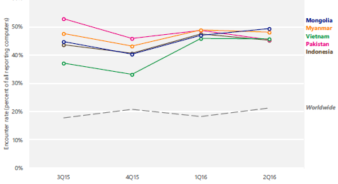
CYBER ENVMT - PAKISTAN
“Microsoft Security Intelligence Report, Volume 21

Slide 103
CYBER ENVMT - PAKISTAN
“Microsoft Security Intelligence Report, Volume 21

Slide 104
CYBER ENVMT - PAKISTAN
“Microsoft Security Intelligence Report, Volume 21

Slide 105
PERCENTAGE OF COMPUTERS DOWNLOADING MALWARES
20 %
15 - 20 %
10 - 15 %
5 - 10 %
0 - 5 %
Insufficient Data
Insufficient Data
Worldwide 7.8 %
Worldwide 7.8 %
* Microsoft Security Intelligence Report, Volume 22 | January through March, 2017

Slide 106
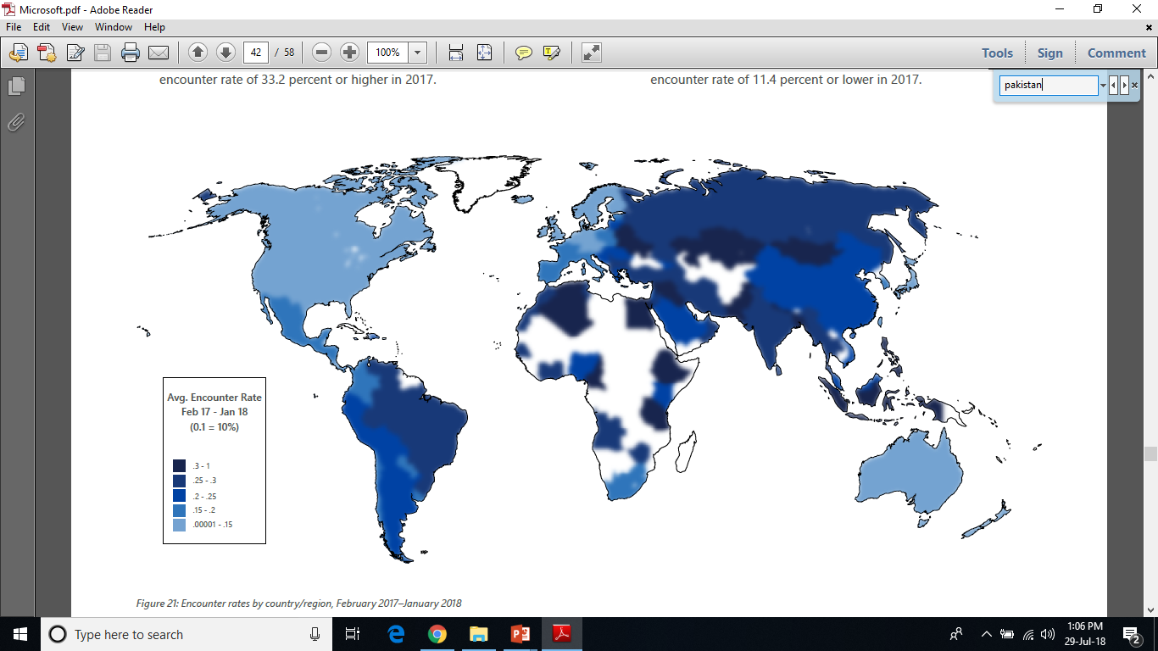
PERCENTAGE OF COMPUTERS DOWNLOADING MALWARES
* Microsoft Security Intelligence Report, Volume 23

Slide 107
PERCENTAGE OF COMPUTERS DOWNLOADING MALWARES

Slide 108
PERCENTAGE OF COMPUTERS DOWNLOADING MALWARES

Slide 109
PERCENTAGE OF COMPUTERS DOWNLOADING MALWARES
Ethiopia
Pakistan
Palestine
26.33
18.94
17.50

Slide 110
The Changing Nature Of Threat
Intruders are prepared and ready
Internet attacks are easy, low risk and hard to trace
Intruder tools are:
Increasingly sophisticated
Easy to use, especially by novice intruders
Designed to support large scale attacks
The complexity of the Internet protocols and applications are all increasing along with our reliance on them
The Internet has become an infrastructure itself

Slide 111
Why Systems Are Not Secure?
Security is an isolated effort– Not integrated
within the systems
Reasons being:
Security is fundamentally difficult
Security is an afterthought
Security is an impediment
False solutions impede progress
The problem is people, not computers
Security Is About Hardware And Software

Slide 112
1. Security is Fundamentally Difficult
Secure Systems Vs. Correct Systems
No major operating system has ever worked perfectly but these systems are reasonably dependable and do the job
Bugs in a function – avoid it
What if it is found by an expert hacker
Ongoing battle b/w designers and the penetrators

Slide 113
1. Security is Fundamentally Difficult
Likelihood of a flaw Vs. Likelihood of a flaw being exploited by a penetrator
Likelihood of flaw (Very high)
Likelihood of flaw being exploited (hope it is low)
Not attaining perfect security
But making the penetrator’s job so difficult, risky, and costly that the value of successful penetration will not be worth the effort

Slide 114
1. Security is Fundamentally Difficult
Systematic Approach Vs. Ad hoc security measures
Administrative controls
Policies
Physical controls
Lock and key
Technical controls
Password
Firewalls
Cryptography
Data Backup

Slide 115
2. Security is an Afterthought
Security appears at the bottom of the list like this:
Functions: What does it do?
Price: What does it cost?
Performance: How fast does it run?
Compatibility: Does it work with earlier products?
Reliability: Will it perform its intended function?
Human Interface: How easy is it to use?
Availability: How often will it break?
•
•
Security Functions: What protection features does it provide?
Security Assurance: How foolproof are the protection features?

Slide 116
2. Security is an Afterthought
Security features – customer dependent
Security is always in demand
It vanishes – if it affects the cost

Slide 117
3. Security is an Impediment
Common user perception: Security is a nuisance
Reason: Poorly integrated ad hoc solutions
Vendors enhancements, made to existing systems at minimal cost, often result in reduced convenience or poor performance
Limited access from remote terminals; restricted physical access to local terminals and printers; multiple passwords or logins; frequent password changes; automatic disconnect after periods of inactivity
→ Security is painful

Slide 118
3. Security is an Impediment
The more robust the security mechanisms are, the more inconvenient the process becomes
Employees in an organization have a job to do; they want to get to work right away
Most security mechanisms, from passwords to multifactor authentication, are seen as roadblocks to productivity
Whole-disk encryption

Slide 119
3. Security is an Impediment
Transportation Security Administration lines at any airport
Security implementations
Total security and total inconvenience
Total insecurity and complete ease of use
The level of security and ease of use must match the acceptable level of risk for the organization

Slide 120
4. False Solutions Impede Progress
Misconception regarding Data Encryption
Securing an operating system is unnecessary if all the files are encrypted
Misconception regarding Use of Passwords
A single password issued to several people
Ex employee
Reenter the password periodically
Windows login password protects data on a computer

Slide 121
5. The Problem is People, not Computers
Insiders
Computer crimes committed by insiders usually do not involve a violation of internal security controls
Absence of Fine grained Controls
People routinely gain access to more information than they need, either because the system is not tuned to provide adequate protection or because implementing such protection is inconvenient or costly

Slide 122
5. The Problem is People, not Computers
Attackers have also identified the average user as
a weak link in the security chain
Companies invest more money in perimeter defenses → attackers looks for the path of least resistance
Why would an attacker struggle to break through an organization’s defenses when end users are more than willing to provide the keys to bank accounts?

Slide 123
6. SECURITY IS NOT ABOUT
HARDWARE AND SOFTWARE
Many businesses believe that if they purchase enough equipment, they can create a secure infrastructure
The purchasing and implementation of security products should be only a percentage of the security budget
Employees tasked with maintaining the security devices should be provided with enough time, training, and equipment to support the products properly

Slide 124
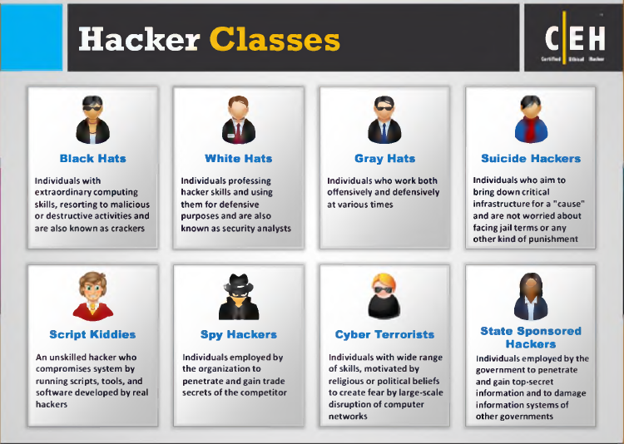
Attacker Types

Slide 125
Common Goals of Attackers
Trophy grabbing
Information theft
Service theft
Identity theft
Tampering
Denial of service (DoS)

Slide 126
Common Vulnerabilities
Implicit trust
Configuration error
Public information
Weak design
Carelessness

Slide 127
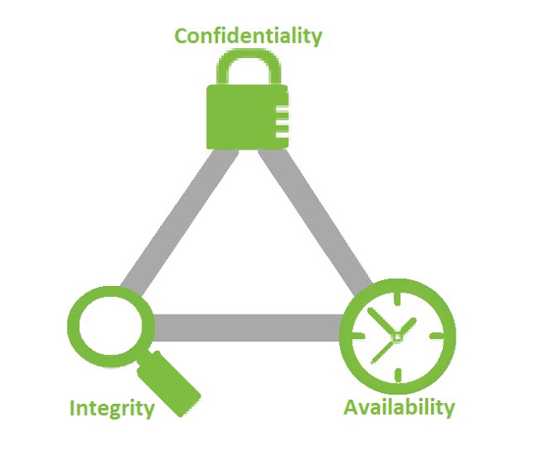
Components of Computer Security

Slide 128
Components of Computer Security
Confidentiality
Concealment of information
Can you name any mechanism ?
Also applies to
Existence of info → more imp than the info itself
Resource hiding

Slide 129
Components of Computer Security
Confidentiality
An unauthorized person accesses a protected asset
A person authorized to access certain data accesses other data for which he is not authorized
An unauthorized person learns the existence of information

Slide 130
Components of Computer Security
Integrity
Protecting information from unauthorized modification
Data integrity (contents)
Origin integrity (source)
Mechanism: Prevention, Detection
Prevention →Unauth attempts to change data or attempts to change data in unauth ways
Detection → don't try to prevent violations but simply report that integrity is no longer there

Slide 131
Components of Computer Security
Integrity
precise
accurate
unmodified
modified only in acceptable ways by authorized people
consistent
meaningful and usable

Slide 132
Components of Computer Security
Availability
Enabling access to data and resources
Availability
Capacity
Performance
Usability
Fault
Tolerance

Slide 133
Components of Computer Security
Availability
Denial of service
Attackers flood victim system with non-legitimate service requests or traffic to overload its resources
The objective of the attacker is not to steal any information from the target; rather to render its services useless or slow down network performance

Slide 134
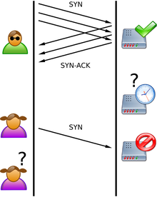

Slide 135
Denial of Service Attack
attacker
A
sends echo request to broadcast address with victim as source
B
C
victim
echo replies
to victim
D

Slide 136
Components of Computer Security
Authentication
Ability of a system to confirm the identity of a sender
Nonrepudiation
Ability of a system to confirm that a sender cannot convincingly deny having sent something
Auditability
Ability of a system to trace all actions related to a given asset

Slide 137
Components of Computer Security
Low
Effectiveness of the organization’s functions are noticeably reduced
Result in minor damage to organizational assets
Moderate
Effectiveness of the organization’s functions are significantly reduced
Result in significant damage to organizational assets
High
Organization is not able to perform its primary functions
Result in major damage to organizational assets
Result in minor financial loss
Result in minor harm to individual
Result in significant financial loss
Result in significant harm to individuals
Result in major financial loss
Result in severe harm to individuals

Slide 138
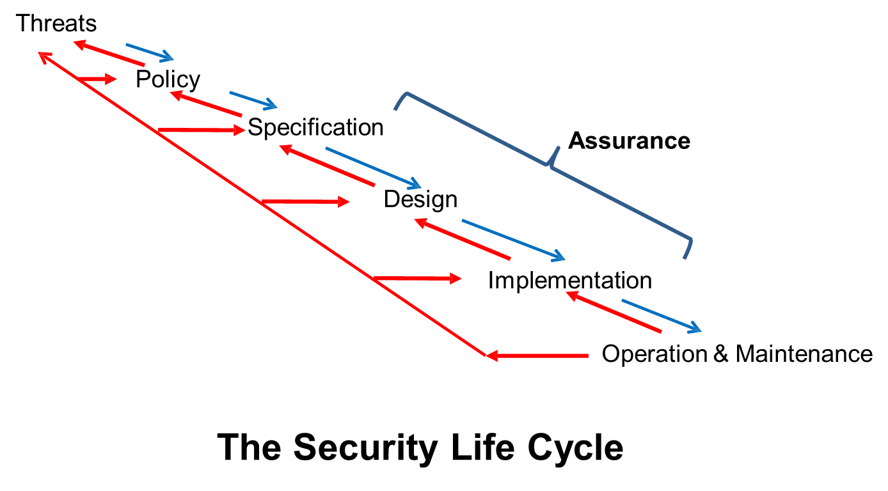

Slide 139
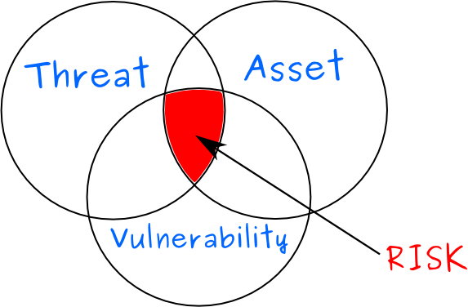

Slide 140
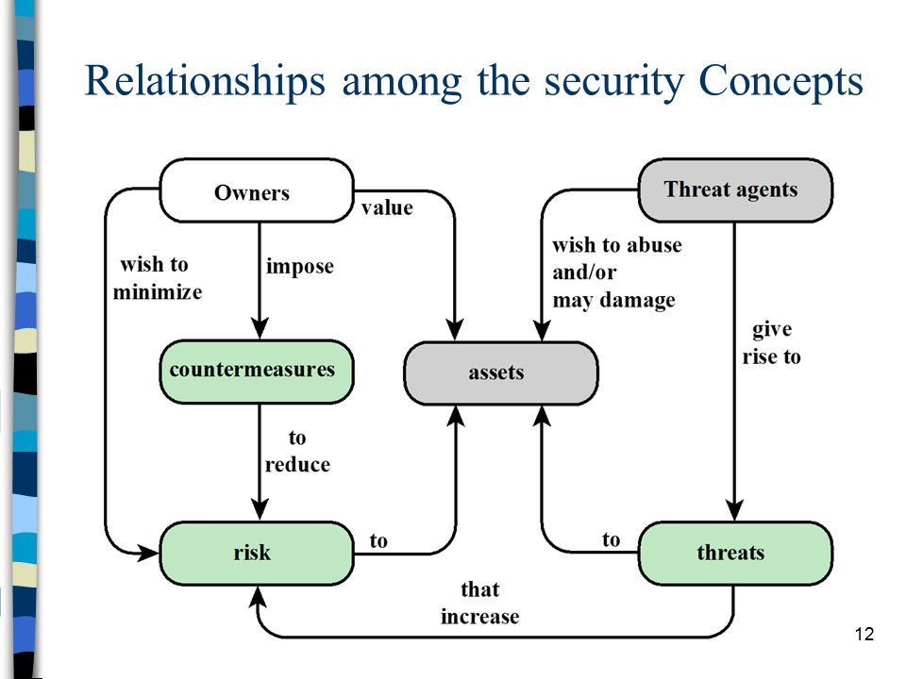

Slide 141

Risk

Slide 142
Classes of Threats
Disclosure
Unauthorized access to information
Deception
Acceptance of false data
Disruption
Interruption or prevention of correct operation
Usurpation
Unauthorized control of some part of a system

Slide 143
Some Common Threats (1)
Snooping: unauthorized interception of information
Threat Class: Disclosure
Security Service: Confidentiality
Modification or alteration: unauthorized change of information
Threat Class: Deception, Disruption and Usurpation, disclosure
Security Service: Integrity
Masquerading or spoofing: impersonation of one
entity by another
Threat Class: Deception and Usurpation, disruption
Security Service: Integrity

Slide 144
Some Common Threats (2)
Repudiation of origin: a false denial that an entity
sent (or created) something
Threat Class: Deception
Security Service: Integrity
Denial of receipt: a false denial that an entity
received some information or message
Threat Class: Deception
Security Service: Integrity

Slide 145
Some Common Threats (3)
Delay: a temporary inhibition of a service
Threat Class: Usurpation, Deception
Security Service: Availability
Denial of service: a long-term inhibition of service
Threat Class: Usurpation, Deception
Security Service: Availability

Slide 147
Policies and Mechanisms
Policy
what is, and is not, allowed
what needs to be done ?
Mechanisms
Methods/ procedures for enforcing policies
How it is to be done ?

Slide 148
Policies and Mechanisms (Example)
Policy
All the employees need to be authenticated before they enter the office
Mechanism
Swipe identity card on an RFID reader
Using a retina/fingerprint scanner

Slide 149
Goals of Security
Prevention
Prevent attackers from violating security policy
Detection
Detect attackers’ violation of security policy
When, how, and by whom
Recovery
Stop attack, assess and repair damage
Continue to function correctly even if attack succeeds

Slide 151
Assurance
Can trust be quantified precisely?
Specification, design and implementation can provide a basis to quantify it
This aspect of trust is called assurance

Slide 152
Assurance (Example)
Asprine
Certification by FDA
Manufacturing standards
Preventive sealing

Slide 153
Assurance
Specification
Statement of desired functionality
What the system is allowed/ not allowed to do
Design
Translates specifications into components that will implement them
Satisfy specifications – doesn’t permit system to violate them
Implementation
Creates a system that satisfies design

Slide 155
Operational Issues
Cost-Benefit Analysis
Is it cheaper to prevent or recover?
If the data or resources cost less, or are of less value, than their protection, adding security mechanisms and procedures is not cost-effective

Slide 156
Operational Issues
Laws and Customs
Laws restrict the use of technology
Hence, any policy and any selection of mechanisms must take into account legal considerations
Are the desired security measures legal?
Would people adopt them?

Slide 157
Operational Issues
Risk Analysis
Risk is dependent on environment
Risks change with time
Should we protect something?
How much should we protect it?
Risk analysis provides a cost/benefit comparison, which compares the annualized cost of controls to the potential cost of loss

Slide 158
Operational Issues
Risk Analysis
A control, in most cases, should not be implemented unless the annualized cost of loss exceeds the annualized cost of the control itself
A facility is worth $100,000, it does not make sense to spend $150,000 trying to protect it

Slide 159

Operational Issues
Risk Analysis

Slide 160
Operational Issues
Risk Analysis
Exposure Factor: The exposure factor (EF) represents the percentage of asset value that will be lost in any incident
For example, if a data warehouse has the asset value of $150,000, if a fire were to occur, 25 percent of the warehouse would be damaged

Slide 161
Operational Issues
Risk Analysis
Single Loss Expectancy: SLE is an amount that represents the company’s potential loss amount if a specific threat was to take place
Asset Value × Exposure Factor (EF) = SLE

Slide 162
Operational Issues
Risk Analysis
The annualized rate of occurrence (ARO) is the value that represents the estimated frequency of a specific threat taking place
if the probability of a fire taking place and damaging a data warehouse is once every ten years, the ARO value is 0.1

Slide 163
Operational Issues
Risk Analysis
Annual Loss Expectancy
ALE is an annual expected financial loss to an organization's asset because of a particular threat occurring within that same calendar year
SLE × Annualized Rate of Occurrence (ARO) = ALE

Slide 164
Operational Issues
Risk Analysis
if a data warehouse has the asset value of $150,000, it can be estimated that if a fire were to occur, 25 percent of the warehouse would be damaged, if the probability of a fire taking place and damaging our data warehouse is once every ten years, what is ALE ?

Slide 165
Operational Issues

Slide 166


Slide 167
Human Issues
Organizational Problems
Power and responsibility
Those responsible should implement controls
Lack of trained people
Work overload
Lack of resources (time, money, people)
People problems
Outsiders and insiders
Untrained people
Social engineering

Slide 168
Tying It All Together

Slide 169
Tying It All Together
A major corporation decided to improve its security
It hired consultants
Threats
Created a policy
Derived several specifications
Developed a design that would meet the
specifications
Implemented the design

Slide 170
Tying It All Together
Implementation phase
Employees could connect modems to telephone
Design – firewall
Sensitive data being sent over email
A new threat was identified - for insider attacks
Review policy

Slide 171
Computer Security – Challenges
Computer security is not as simple. The requirements seem to be straightforward (CIA) but the mechanisms used to meet those requirements can be quite complex
In developing a particular security mechanism, one must look at a problem in a completely different way
Security measures often seem counterintuitive until the various aspects of the threat are considered that elaborate security mechanisms make sense

Slide 172
Computer Security – Challenges
Having designed various security mechanisms, it is necessary to decide where to use them
Computer security is essentially a battle of wits between a perpetrator who tries to find holes and the designer or administrator who tries to close them
Attacker needs to find a single weakness while the designer must find and eliminate all weaknesses to achieve acceptable security

Slide 173
Computer Security – Challenges
There is a natural tendency on the part of users and system managers to perceive little benefit from security investment until a security failure occurs
Security requires regular and constant monitoring, and this is difficult in today’s environment
Security is still too often an afterthought to be incorporated into a system after the design is complete rather than being an integral part of the design process

Slide 174
Computer Security – Requirements
There are a number of ways of classifying and characterizing the countermeasures that may be used to reduce vulnerabilities and deal with threats to system assets
Technical Measures
Management Measures

Slide 175
Computer Security – Requirements
Computer security technical measures
Access Control
Limit information system access to authorized user or processes acting on behalf of authorized users, and to the types of functions that authorized users are permitted to exercise

Slide 176
Computer Security – Requirements
Computer security technical measures
Identification and Authentication
Identify information system users & processes acting on behalf of users and authenticate the identities of those users & processes as a prerequisite to allowing access to organizational information systems

Slide 177
Computer Security – Requirements
Computer security technical measures
Systems and Communication Protection
Monitor, control, and protect organizational communications at the external boundaries and key internal boundaries of the information systems

Slide 178
Computer Security – Requirements
Computer security technical measures
System and Information Integrity
Identify, report, and correct information in a timely manner

Slide 179
Computer Security – Requirements
Management Measures
Awareness and Training
Users of organizational are made aware of the security risks associated with their activities and of the applicable laws, regulation, and policies related to the security of organizational information systems
Users are trained to carry out their assigned information security-related duties and responsibilities

Slide 180
Computer Security – Requirements
Management Measures
Audit and Accountability
Create, protect, and retain information system audit records to enable the monitoring, analysis, investigation, and reporting of unlawful, unauthorized, information system activity
Actions of individual information system users can be uniquely traced to those users so they can be held accountable for their actions

Slide 181
Computer Security – Requirements
Management Measures
Security Assessments
Periodically assess the security controls in Organizational information systems to determine if the controls are effective in their application
Implement measures to correct deficiencies and reduce or eliminate vulnerabilities in organizational information systems

Slide 182
Computer Security – Requirements
Management Measures
Contingency Planning
Establish, maintain, and implement plans for emergency response, backup operations, and post disaster recovery for organizational information systems to ensure the availability of critical information resources and continuity of operations in emergency situations

Slide 183
References
Computer Security, by Matt Bishop
Building A Secure Computer System, by Morrie
Gasser
Computer Security, by William Stallings

